Slide 1
West Virginia Retiree Health Benefit Trust Fund
and
PEIA Finance Board Meeting
Thursday, December 1, 2016, 1:00 p.m.
Canaan Valley Room 1041, DEP Building, 601 57th Street, SE
Charleston, WV 25304

Slide 2
Agenda
Roll Call
Call to Order
Approval of Minutes
FY18 Finance Plan Recommendations
Public Comments
Motion to accept Plan Recommendations
Director Update
Old Business
New Business
Next Meeting – March 16, 2017

Slide 3
Roll Call
Mary Jane Pickens, Chairman
Members:
Brian Donat
James W. Dailey, II
Troy Giatras
Elaine Harris
William “Bill” Ihlenfeld
William “Bill” Milam
Michael T. Smith
Joshua Sword

Slide 4
Approval of Minutes October 13, 2016
Mary Jane Pickens
Chairman

Slide 5
FY18 FINANCE PLAN RECOMMENDATIONS
By: Ted Cheatham, Director, PEIA

Slide 6
WV PEIA Local Fund
Financial Plan FY 2017 - FY 2021

Slide 7
Non-State Employees
1. Premium increase 6%
Additional Revenue $6.6 million
2. Plan structure changes
Plan Savings $1,000,000
 | In West Virginia | Outside West Virginia with Approval from HealthSmart | Outside West Virginia without Approval from HealthSmart
Plan A | 80/20 | 70/30 | 60/40
Plan B | 70/30 | 65/35 | 50/50
Plan C High Deductible Health Plan | No Change | No Change | No Change
Plan D | 80/20 | 70/30 | n/a

Slide 8
3. Premiums for Plan A, B and D may be adjusted
Plan A and D +1.3%
Plan B -5.0%
Increase deductible and out-of-pocket maximum amounts in PEIA PPB Plans A, B, and D
Increase deductible by $200 single/$400 family
Increase out-of-pocket maximum by $1,000 single/$2,000 family
Plan Savings $4.3 million
All MHP/PCP copayments to $20 (CCP remains the same)
Plan Savings $76,000
Increase specialty drug copayments to $100/$150
Plan Savings $43,000
Increase the number of outpatient procedures subject to maximum facility fees (see pages 9 and 10)

Slide 9
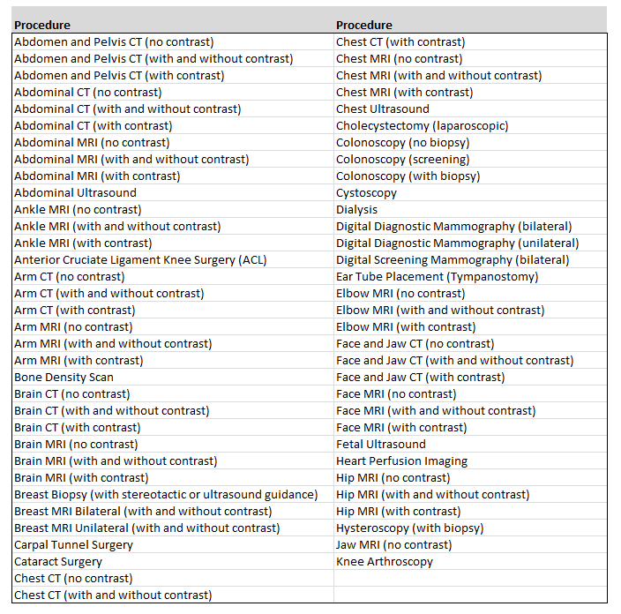

Slide 10
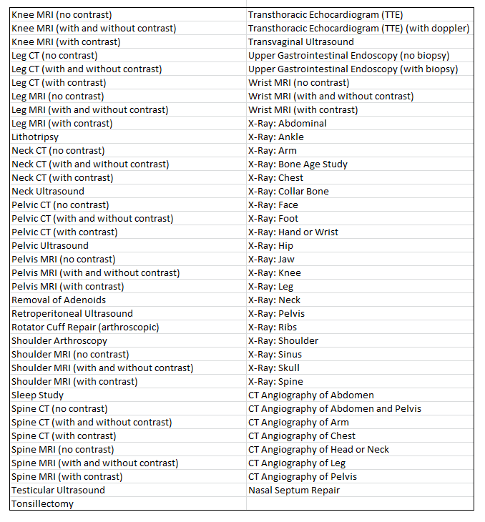

Slide 11
8. Prescription Changes:
Leave cost-sharing the same
Implement mandatory 90-day prescription fill for all maintenance medications
Plan Savings $1.6 million
Example 1: Generic: Drug A
Your cost is $20 (2 x $10 copayment for 90 day supply)
Example 2: Preferred brand: Drug B
Your cost is $50 (2 x $25 copayment for 90 day supply)
Example 3: Non-preferred brand: Drug C costs $500 for 90 day supply
Your cost is $500 x .75 = $375
Drugs on the maintenance medication list would not be covered in anything less than a 90-day supply.

Slide 12
WV PEIA State Fund
Financial Plan FY 2017 - FY 2021

Slide 13
Active State Employees
Plan structure changes
Plan Savings of $3,100,000
 | In West Virginia | Outside West Virginia with Approval from HealthSmart | Outside West Virginia without Approval from HealthSmart
Plan A | 80/20 | 70/30 | 60/40
Plan B | 70/30 | 65/35 | 50/50
Plan C High Deductible Health Plan | No Change | No Change | No Change
Plan D | 80/20 | 70/30 | n/a

Slide 14
Premiums may be adjusted as follows:
Plan A and D +0.5%
Plan B -5.0%
Increase cost-sharing amounts in PEIA PPB Plans A, B, and D
Increase deductible by $200 single/$400 family
Increase out-of-pocket maximum by $1,000 single/$2,000 family
Plan Savings $19.4 million
4. All MHP/PCP copayments to $20 (CCP remains the same)
Plan Savings $428,000
5. Increase specialty drug copayments to $100/$150
Plan Savings $200,000
6. Increase the number of outpatient procedures subject to maximum facility fees (see pages 9 and 10)

Slide 15
7. Prescription changes:
Leave cost-sharing the same
Implement mandatory 90 day prescription fill for all maintenance medications
Plan Savings $7.7 million
Example 1: Generic: Drug A
Your cost is $20 (2 x $10 copayment for 90 day supply)
Example 2: Preferred brand: Drug B
Your cost is $50 (2 x $25 copayment for 90 day supply)
Example 3: Non-preferred brand: Drug C costs $500 for 90 day supply
Your cost is $500 x .75 = $375
Drugs on the maintenance medication list would not be covered in anything less than a 90-day supply.

Slide 16
WV RHBT Non-Medicare Fund
Financial Plan FY 2017 - FY 2021

Slide 17
Non-Medicare Retirees
Premium increase 4%
Additional revenue $1,690,823
Plan structure changes
Plan Savings $.25 million
 | In West Virginia | Out-of-State with Approval from HealthSmart | Out-of-State without Approval from HealthSmart
Plan A | 80/20 | 70/30 | 60/40
Plan B | 70/30 | 65/35 | 50/50

Slide 18
3. Premiums may be adjusted as follows
Plan A +0.5%
Plan B -5.0%
Increase cost-sharing amounts in PEIA PPB Plans A and B
Increase deductible by $100 single/$200 family
Family out-of-pocket maximum increase Plan A to $3,000 and Plan B to $6,000
Non-Medicare retiree with Medicare dependents out-of-pocket maximum to $2,700 ($1,500 single oopm + $1,200 Medicare oopm)
Plan Savings $970,000
All MHP/PCP copayments to $20 (CCP remains the same)
Plan Savings $96,000
Increase specialty drug copayments to $100/$150
Plan Savings $50,000
Increase the number of outpatient procedures subject to maximum facility fees (see pages 9 and 10)

Slide 19
8. Prescription changes:
Leave cost-sharing the same
Implement mandatory 90-day prescription fill for all maintenance medications
Plan Savings $1.7 million
Example 1: Generic: Drug A
Your cost is $20 (2 x $10 copayment for 90 day supply)
Example 2: Preferred brand: Drug B
Your cost is $50 (2 x $25 copayment for 90 day supply)
Example 3: Non-preferred brand: Drug C costs $500 for 90 day supply
Your cost is $500 x .75 = $375
Drugs on the maintenance medication list would not be covered in anything less than a 90-day supply.

Slide 20
WV RHBT Medicare Fund
Financial Plan CY 2017 - CY 2021

Slide 21
Medicare Retirees – Humana/PEIA
Plans 1 and 2 and Special Medicare Plan
4% rate increase
Additional Revenue $2.8 million
2. Increase deductible and out-of-pocket maximum amounts
Increase deductible by $50
Increase out-of-pocket maximum by $450
Plan Savings $2.8 million

Slide 22
Pharmacy changes Humana/PEIA Plans 1 and 2
Tier 1 – Generic drugs $5
Tier 2 – Preferred brand drugs $15
Tier 3 – Non-preferred brand drugs 50% coinsurance
Tier 4 – Specialty drugs $100
Plan Savings $6.7 million

Slide 23
Special Medicare Plan
Medical benefits follow the Humana/PEIA Plan 1 benefits
2. Pharmacy benefits follow PEIA PPB Plan A prescription benefits

Slide 24
Retiree Benefit Assistance
Increase medical deductible by $25
2. Increase medical out-of-pocket maximum by $300
3. Pharmacy changes:
Tier 1 – Generic drugs $5
Tier 2 – Preferred brand drugs $15
Tier 3 – Non-preferred brand drugs 50% coinsurance
Tier 4 – Specialty drugs $100

Slide 25
Public Comment
Mary Jane Pickens
Chairman

Slide 26
Motion to accept FY 18 Finance Plan Recommendations
Mary Jane Pickens
Chairman

Slide 27
Director Update
Ted Cheatham, PEIA Director

Slide 28
Old Business
Mary Jane Pickens
Chairman

Slide 29
New Business
Mary Jane Pickens
Chairman

Slide 30
Schedule Next Meeting March 16, 2017, 1:00 pm
Mary Jane Pickens
Chairman

Slide 31
Adjourn
Mary Jane Pickens
Chairman

Slide 32
If you want to request a copy of today’s meeting materials, please contact:
Vicki Jones
(304) 957-2620
Vicki.L.Jones@wv.gov

