Slide 1

PEIA
Public Hearings
November 2017
Benefits for Plan Year 2019
Calendar 2019 for Medicare Retirees
July 1, 2018 – June 30, 2019 for all others

Slide 2
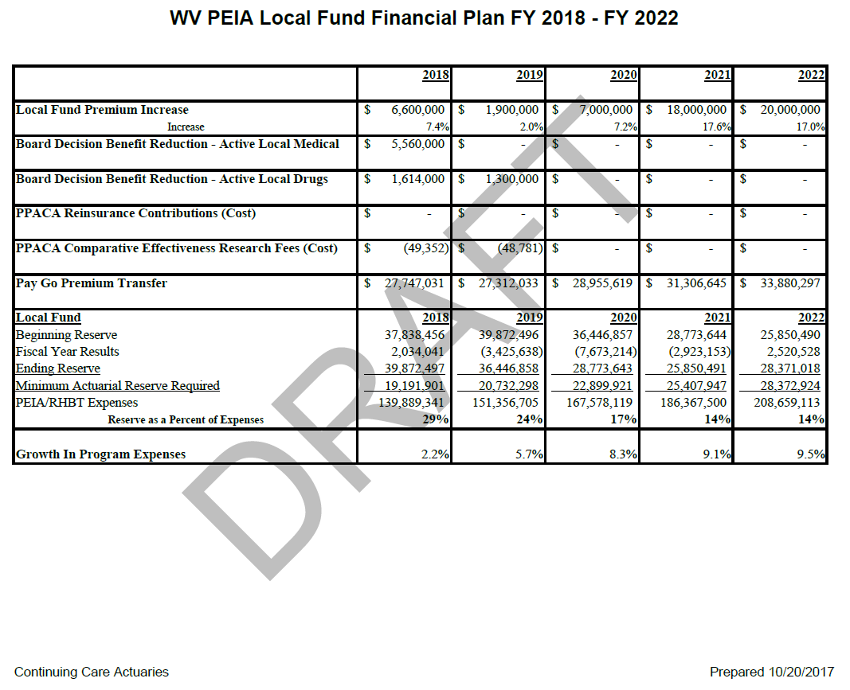

Slide 3
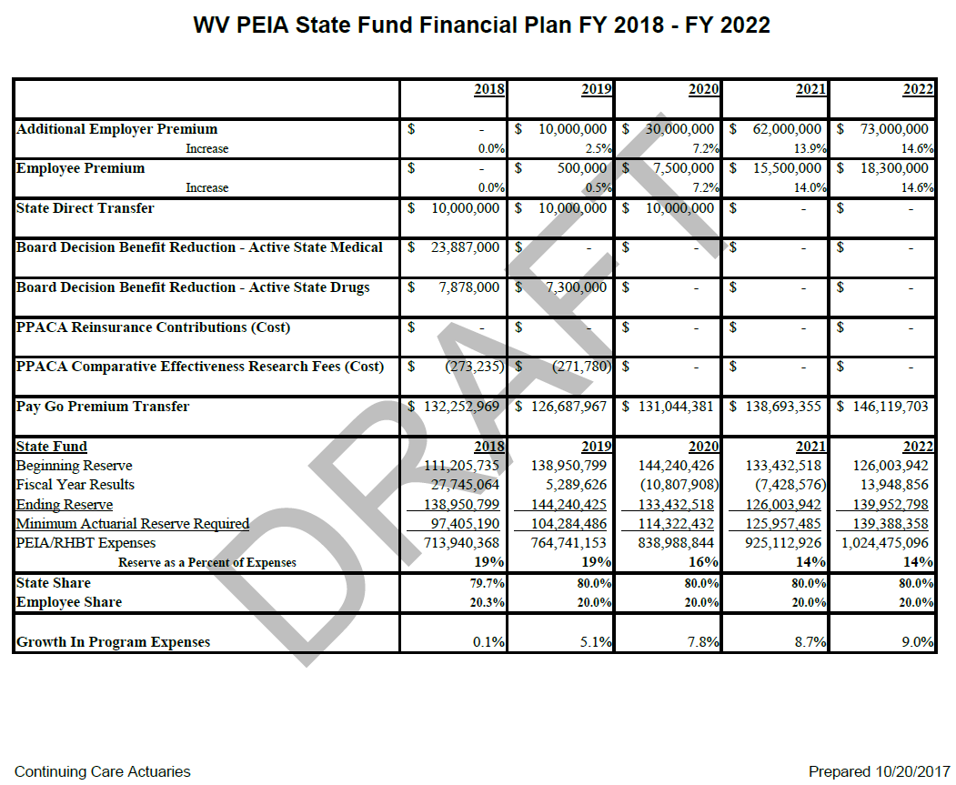

Slide 4
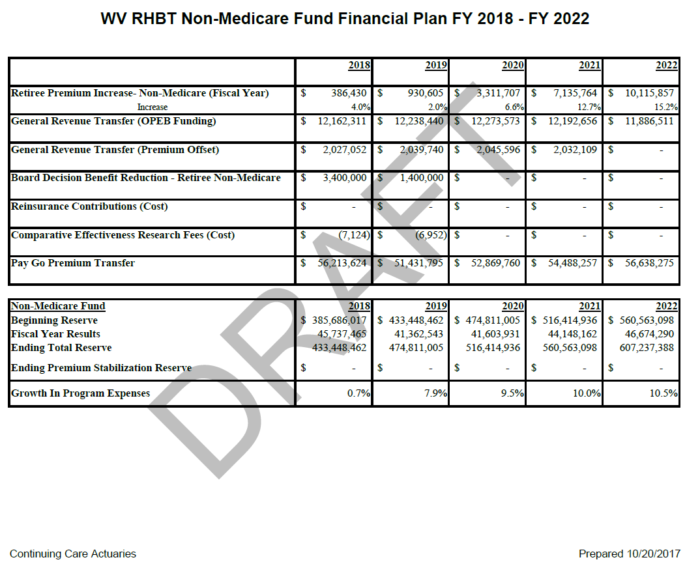

Slide 5
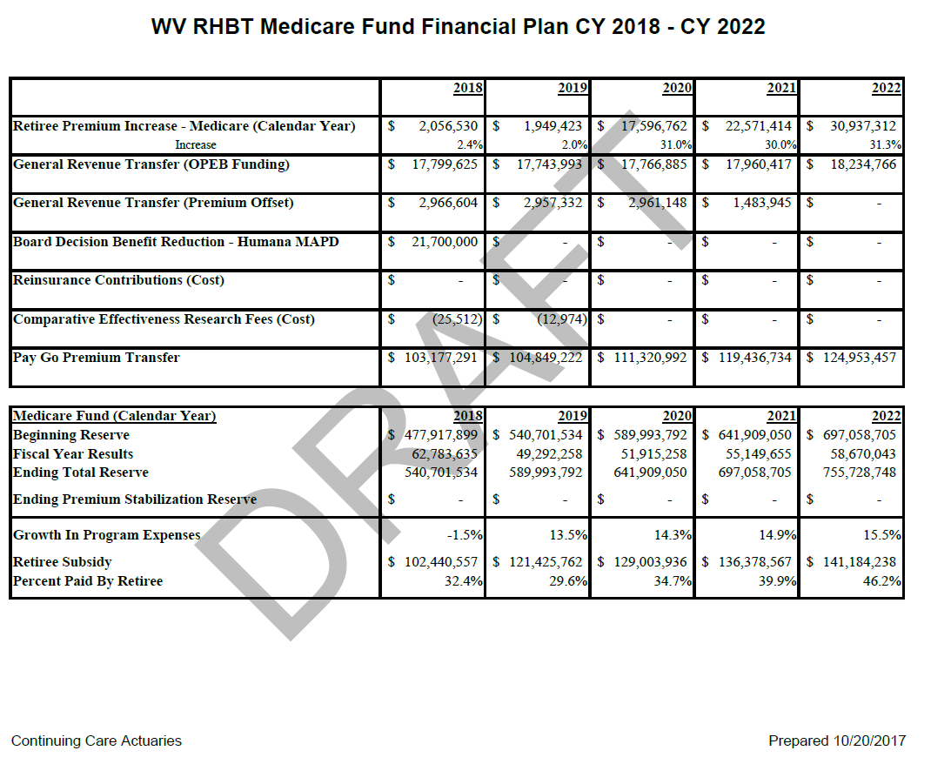

Slide 6
Non-State Proposal
2% Rate Increase
Remove pharmacy deductible (plan A, B , D)
Change pharmacy 2nd tier, Preferred Brand, from $25/$30 to 30% coinsurance ($25 minimum, $100 maximum per 30-day script)
  90-day supply of Preferred Brand would be 30% coinsurance ($50 minimum and $200 maximum

Slide 7
Increase preferred brand drugs (2nd tier) to 30% coinsurance examples
(Minimum - $25, Maximum - $100 for a 30 day supply or,
Minimum -$50, Maximum - $200 for a 90 day supply)
Example 1
Preferred brand drug A costs $250 for a 30 day supply
Your cost is $250 x .30 = $75
Example 2
Preferred brand drug B costs $1,000 for a 90 day supply
Your cost is $1,000 x .30 = $300 or $200 maximum so your cost is $200
Example 3
Preferred brand drug C costs $40 for a 90 day supply
Your cost is $40 x .30 = $12 or $50 minimum, since this is below your minimum, your cost is $40

Slide 8
Active State Employee Proposal
.5% Rate Increase
Remove pharmacy deductible (plan A, B , D)
Change pharmacy 2nd tier, Preferred Brand, from $25/$30 to 30% coinsurance ($25 minimum, $100 maximum per 30-day script)
  90-day supply of Preferred Brand would be 30% coinsurance ($50 minimum and $200 maximum
Move from 10 to 3 salary tiers, deductibles, and out-of-pockets
Use total family income if spouses are covered
Pay by Person

Slide 9
Current Structure
2018 |  | Plan A | Plan B | Plan C | Plan D
 |  | FY 2018 | FY 2018 | FY 2018 | FY 2018
 |  | Single Coverage | Single Coverage | Single Coverage | Single Coverage
Salary Range |  | Monthly Premium | Monthly Premium | Monthly Premium | Monthly Premium
Single Coverage |  | Standard | Standard | Standard | Standard
$ - | $ 20,000 | $64 | 44 | 85 | $53
20,001 | 30,000 | $81 | 50 | 85 | $68
30,001 | 36,000 | $88 | 53 | 85 | $75
36,001 | 42,000 | $94 | 55 | 85 | $79
42,001 | 50,000 | $109 | 61 | 85 | $93
50,001 | 62,500 | $132 | 71 | 85 | $112
62,501 | 75,000 | $146 | 78 | 85 | $124
75,001 | 100,000 | $176 | 90 | 85 | $149
100,001 | 125,000 | $219 | 127 | 85 | $186
125,001 | + | $249 | 150 | 85 | $212
Employer Premium |  | $465 | $ 329 | $ 384 | $ 399
 |  | Employee & Children Coverage | Employee & Children Coverage | Employee & Children Coverage | Employee & Children Coverage
Salary Range |  | Monthly Premium | Monthly Premium | Monthly Premium | Monthly Premium
Employee/Child |  | Standard | Standard | Standard | Standard
$ - | $ 20,000 | $127 | 74 | 182 | $106
20,001 | 30,000 | $151 | 83 | 182 | $126
30,001 | 36,000 | $160 | 87 | 182 | $134
36,001 | 42,000 | $174 | 91 | 182 | $145
42,001 | 50,000 | $208 | 113 | 182 | $175
50,001 | 62,500 | $250 | 146 | 182 | $211
62,501 | 75,000 | $283 | 166 | 182 | $238
75,001 | 100,000 | $346 | 208 | 182 | $293
100,001 | 125,000 | $410 | 262 | 182 | $347
125,001 | + | $467 | 302 | 182 | $397
Employer Premium |  | 579 | $ 414 | $ 483 | $ 501
 |  | Family Coverage | Family Coverage | Family Coverage | Family Coverage
Salary Range |  | Monthly Premium | Monthly Premium | Monthly Premium | Monthly Premium
Family |  | Standard | Standard | Standard | Standard
$ - | $ 20,000 | $185 | $118 | $304 | $149
20,001 | 30,000 | $234 | $145 | $304 | $192
30,001 | 36,000 | $261 | $159 | $304 | $215
36,001 | 42,000 | $291 | $175 | $304 | $239
42,001 | 50,000 | $341 | $207 | $304 | $283
50,001 | 62,500 | $409 | $251 | $304 | $341
62,501 | 75,000 | $442 | $275 | $304 | $369
75,001 | 100,000 | $528 | $343 | $304 | $443
100,001 | 125,000 | $646 | $431 | $304 | $544
125,001 | + | $747 | $499 | $304 | $630
Employer Premium |  | 946 | $ 673 | $ 784 | $ 815
**FAMILY with EMPLOYEE SPOUSE POLICY TIER WILL NO LONGER BE AVAILABLE**

Slide 10
Proposed Single + Dependent Premiums
 |  | Revenue Neutral with TFI
Single and EE/CH Coverage
Employee Salary |  | Employee Premiums
 |  | Plan A | Plan B | Plan C | Plan D
$ - | $ 36,000 | $ 64 | $ 44 | $ 85 | $ 53
$ 36,001 | $ 62,500 | $ 94 | $ 55 | $ 85 | $ 79
$ 62,501 | + | $ 147 | $ 78 | $ 85 | $ 125
Family Coverage (Policy Holder Total Family Income)
 |  | Plan A | Plan B | Plan C | Plan D
$ - | $ 36,000 | $ 64 | $ 44 | $ 85 | $ 53
$ 36,001 | $ 62,500 | $ 94 | $ 55 | $ 85 | $ 79
$ 62,501 | + | $ 147 | $ 78 | $ 85 | $ 125
Additional Premiums for policy Members:
Dependent Premiums
Dependent Under Age 21 (3 max) |  | $ 51 | $ 30 | $ 46 | $ 43
Dependent Age 21+ |  | $ 73 | $ 43 | $ 66 | $ 61
Spouse |  | $ 146 | $ 85 | $ 132 | $ 122
Employer Premiums
Single |  | $ 454 | $ 322 | $ 375 | $ 390
Two |  | $ 568 | $ 402 | $ 469 | $ 487
Three+ |  | $ 994 | $ 703 | $ 821 | $ 853
With Total Family Income for Family Coverage *employee/employee spouse discount will no longer be available
3 Tiers with TFI
Single Coverage
Employee Salary |  | Deductible |  |  |  | Out-of-Pocket Maximum
 |  | Plan A | Plan B | Plan C | Plan D | Plan A | Plan B | Plan C | Plan D
$ - | $ 36,000 | $ 350 | $ 725 | $ 1,300 | $ 350 | $ 1,825 | $ 3,000 | $ 2,500 | $ 1,825
$ 36,001 | $ 62,500 | $ 475 | $ 725 | $ 1,300 | $ 475 | $ 2,525 | $ 3,000 | $ 2,500 | $ 2,525
$ 62,501 | + | $ 650 | $ 1,225 | $ 1,300 | $ 650 | $ 2,875 | $ 3,000 | $ 2,500 | $ 2,875
Employee and Children and Family
Employee Salary |  | Deductible |  |  |  | Out-of-Pocket Maximum
 |  | Plan A | Plan B | Plan C | Plan D | Plan A | Plan B | Plan C | Plan D
$ - | $ 36,000 | $ 700 | $ 1,450 | $ 2,600 | $ 700 | $ 3,650 | $ 6,000 | $ 5,000 | $ 3,650
$ 36,001 | $ 62,500 | $ 950 | $ 1,450 | $ 2,600 | $ 950 | $ 5,050 | $ 6,000 | $ 5,000 | $ 5,050
$ 62,501 | + | $ 1,300 | $ 2,450 | $ 2,600 | $ 1,300 | $ 5,750 | $ 6,000 | $ 5,000 | $ 5,750
*The example numbers in the charts above are for illustrative purposes only and meant to provide general guidance. These estimated numbers are subject to change based on several factors, and the final values will be published in the 2018 Shopper’s Guide.

Slide 11
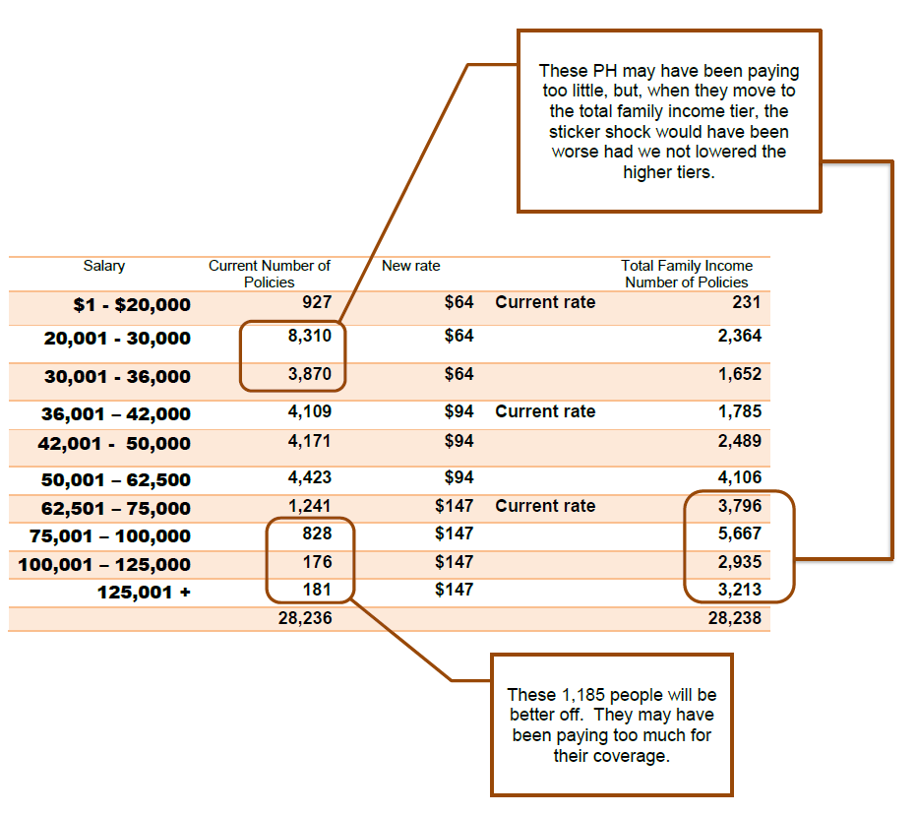
11

Slide 12
How Do We Get Total Family Income?
Only applies if the spouse is covered by PEIA
Total family income is defined as the sum of both married spouses adjusted gross income.
  Example:
    Line 37 of Form 1040
    Line 6 of Form 1040EZ
    Line 21 of Form 1040A
The family income number to be used will be the higher of actual policy holder salaries or the sum of the family adjusted gross income
A form will be available to report total family income. Failure to provide total family income on this form will cause a default to the highest income and premium tier.

Slide 13
Non-Medicare Retiree and Special Medicare Plan Proposal
2% Rate Increase
Remove pharmacy deductible
Change pharmacy 2nd tier, Preferred Brand, from $25/$30 to 30% coinsurance ($25 minimum, $100 maximum per 30-day script)
  90-day supply of Preferred Brand would be 30% coinsurance ($50 minimum and $200 maximum
Pay by Person

Slide 14
Chart for Pay by Person Non-Medicare and Special Medicare Retiree Plans
Current Rates
Proposed Rates
PEIA PPB non-Medicare Retiree Rates
Plan A
Non Med Policyholder Only
Hired After July 1, 2010 | $ 1,160
5 to 9 years | $ 929
10 to 14 years | $ 716
15 to 19 years | $ 501
20 to 24 years | $ 375
25 or more years | $ 291
Non Med Policyholder with Non Med Dependents
 | 2018
 | Standard
Hired After July 1, 2010 | $ 2,760
5 to 9 years | $ 2,209
10 to 14 years | $ 1,665
15 to 19 years | $ 1,124
20 to 24 years | $ 799
25 or more years | $ 582
Non Med Policyholder with Med Dependents
 | 2018
 | Standard
Hired After July 1, 2010 | $ 1,934
5 to 9 years | $ 1,548
10 to 14 years | $ 1,153
15 to 19 years | $ 760
20 to 24 years | $ 526
25 or more years | $ 367
 | Non-Medicare Retired (Plan A) | Non-Medicare Retired (Plan B)
Unsubsidized Premium | $1,183 | $1,085
5-9 years | $948 | $870
10-14 years | $730 | $671
15-19 years | $511 | $470
20-24 years | $383 | $352
25+ years | $297 | $272
Non-Medicare Spouse | $288 | $265
Medicare Spouse | $115 | $106
Non-Medicare Dependent 21+ | $95 | $88
Non-Medicare Dependent Under 21 (3 max) | $67 | $61
Medicare Dependent | $104 | $95
*The example numbers in the charts above are for illustrative purposes only and meant to provide general guidance. These estimated numbers are subject to change based on several factors, and the final values will be published in the 2018 Shopper’s Guide.

Slide 15
Medicare Retiree Proposal (Humana)
2% Rate Increase
Remove pharmacy deductible
Increase Generic tier from $5 to $10
Change pharmacy 2nd tier, Preferred Brand, from $15/$20 to 30% coinsurance ($25 minimum, $100 maximum per 30-day script)
  90-day supply of Preferred Brand would be 30% coinsurance ($50 minimum and $200 maximum
Pay by Person

Slide 16
Chart for Pay by Person -- Medicare
Current Rates
Proposed Rates
PEIA PPB Medicare Retiree Rates Plan 1
Med Policyholder Only
 | 2018
 | Standard
Hired After July 1, 2010 | $ 473
5 to 9 years | $ 431
10 to 14 years | $ 317
15 to 19 years | $ 204
20 to 24 years | $ 136
25 or more years | $ 91
Med Policyholder with non Med
 | 2018
 | Standard
Hired After July 1, 2010 | $ 1,583
5 to 9 years | $ 1,440
10 to 14 years | $ 1,083
15 to 19 years | $ 727
20 to 24 years | $ 512
25 or more years | $ 370
Med Policyholder with Med
 | 2018
 | Standard
Hired After July 1, 2010 | $ 974
5 to 9 years | $ 886
10 to 14 years | $ 640
15 to 19 years | $ 395
20 to 24 years | $ 246
25 or more years | $ 150
 | Medicare Humana/PEIA PLAN 1 | Medicare Humana/PEIA PLAN 2
Hired on or after July 1, 2010 | $467 | $435
5 to 9 years | $425 | $391
10 to 14 years | $313 | $285
15 to 19 years | $201 | $181
20 to 24 years | $135 | $119
25 or more years | $90 | $78
Non-Medicare Spouse | $238 | $214
Medicare Spouse | $95 | $86
Non-Medicare Dependent 21+ | $70 | $63
Non-Medicare Dependent Under 21 (3 max) | $49 | $44
Medicare Dependent | $76 | $68
*The example numbers in the charts above are for illustrative purposes only and meant to provide general guidance. These estimated numbers are subject to change based on several factors, and the final values will be published in the 2018 Shopper’s Guide.

Slide 17
Retiree Assistance
Remove pharmacy deductible
Change pharmacy 2nd tier, Preferred Brand, from $10/$20 to 30% coinsurance ($25 minimum, $100 maximum per 30-day script)
  90-day supply of Preferred Brand would be 30% coinsurance ($50 minimum and $200 maximum
Pay by Person

Slide 18
New Programs
iSelectMD – telemedicine vendor
  lets you talk to a physician, get a diagnosis, treatment recommendations, and even prescriptions over the phone
  call 1-877-775-3006 x1 24/7
  the access code is : WV1144
  $40 copay
Rx Savings Solutions – new partner who will work with you to lower your prescription drug costs
  Register on their website
  Get an analysis of your prescription costs, and where you can save money
  Once registered, they’ll send you alerts when you can save money on a drug

Slide 19
Healthy Tomorrows Future
New wellness vendor: Humana Go365
Next phase of the Healthy Tomorrows program
  Those who met the Healthy Tomorrows goals for this plan year don’t have to submit bloodwork by 5/15/18
  Those who DIDN’T meet the Healthy Tomorrows goals for this year MUST submit bloodwork within range (or have a doc’s statement that they can’t) by 5/15/18 or pay $500 penalty deductible and $25 extra premium per month
  Go365 website will be open for you to try in January
  Start earning points in July
Active employees and non-Medicare retirees only
  Policyholders only – no spouses or dependents required

Slide 20
Launch Announcement
Healthy Tomorrows is adding incentives! Program transition details for January-June 2018
If you met the Healthy Tomorrows requirements for 7/1/17 | If you have not met the Healthy Tomorrows requirements for 7/1/17 | ALL EMPLOYEES Beginning 1/1/18
Congratulations! You do not need to submit a Healthy Tomorrows form by May 15, 2018. You will not be charged the $500 penalty deductible or the $25/mo premium increase starting July 2018 (for the 2019 Plan Year). | There is still work to do! You still need to Complete Healthy Tomorrows form & be in range by May 15, 2018 If you do not, you will incur a $500 penalty deductible and pay $25/mo premium increase starting July 1, 2018 | Go Play with Go365! Learn the program Have fun, build experience, and earn additional rewards for healthy activities including Amazon gift cards and fitness devices.
To get started with Go365 visit https://www.go365.com/ or download the Go365 app from your Android or iTunes App Store
20

Slide 21
Four-Year Healthy Tomorrows Strategy
Year 4 7/1/2018 – 6/30/2019 | Year 5 7/1/2019 – 6/30/2020 | Year 6 7/1/2020 – 6/30/2021 | Year 7 7/1/2021 – 6/30/2022
To avoid penalty the following year*:
Earn 3,000 Points By May 15, 2019 | Earn 5,000 Points by May 15, 2020 | Earn 8,000 Points by May 15, 2021 | Earn 8,000 Points AND be Negative for Metabolic Syndrome** by May 15, 2022.
*In order to avoid $500 deductible increase and $25 monthly premium increase.
**Metabolic Risk Syndrome is a cluster of conditions – increased blood pressure, a high blood sugar level, excess body fat around the waist and abnormal cholesterol levels – that occur together, increasing the risk of heart disease, stroke and diabetes. To be negative for metabolic syndrome a member must have at least 3 of the 5 risk factors in a healthy range (weight, cholesterol, triglycerides, blood pressure, and blood glucose).
21

Slide 22


What is Go365?
22

Slide 23
Healthy Tomorrows Earning Points
Education | Fitness | Prevention | Healthy Living
Some opportunities are fixed, we can add opportunities
Health Assessment - 500/yr; 500 points once in lifetime bonus; 250 fast bonus if within first 90 days Sleep diary 25/wk; Up to 150/yr Health coaching up to 600/yr Calculators up to 300/yr CPR/first aid 125/yr each Daily health quiz 2pts | Daily points up to 50/day Sports league up to 1400/yr Challenges up to 100/mo Athletic events 250-500 each; Up to 3,000/yr | Health screenings 400 Flu shot 200/yr Biometric screenings 2000 points | IN RANGE biometrics up to an additional 2000 points Blood donation 50/each; 300/yr
23

Slide 24



Healthy Food Program
Play games - Web or Go365 app once a month
Discounts range between 5 and 50%
Look for healthy food items with a symbol at Walmart
4. At register, show your membership and
receive your discount on healthy food
items
24

Slide 25
Questions/Comments

