Slide 1
PEIA Plan Year 2018
Open Enrollment Training
Open Enrollment: April 2 - May 15. 2017

Slide 2
OE Training
Non-State Changes for PY 2018
State, (BOE and University are considered state for this training) Changes for PY 2018
Non-Medicare Retiree Changes for PY 2018
Healthy Tomorrows
iSelectMD
Prescription Changes for PY 2018
Rx Savings
Facility Fee Limit Changes for PY 2018

Slide 3
Non-State Employees
Premium increase 6%

Slide 4
Active State Employees and Non-State Employees
 | In West Virginia | Outside West Virginia with Approval from HealthSmart | Outside West Virginia without Approval from HealthSmart
Plan A | 80/20 | 70/30 | 60/40
Plan B | 70/30 | 65/35 | 50/50
Plan C High Deductible | No Change | No Change | No Change
Plan D | 80/20 | 70/30 | n/a
*This includes network providers in contiguous counties of surrounding states. Members may still use those providers without prior approval, but will pay the higher coinsurance amount for services.
**** Emergencies Included on the higher amount if it is not
pre-certified

Slide 5
Active State Employees and Non-State Employees
Increase deductible and out-of-pocket maximum amounts in PEIA PPB Plans A, B, and D
    Increase deductible by $200 single/
    $400 family
    Increase out-of-pocket maximum by
    $1,000 single/$2,000 family

Slide 6
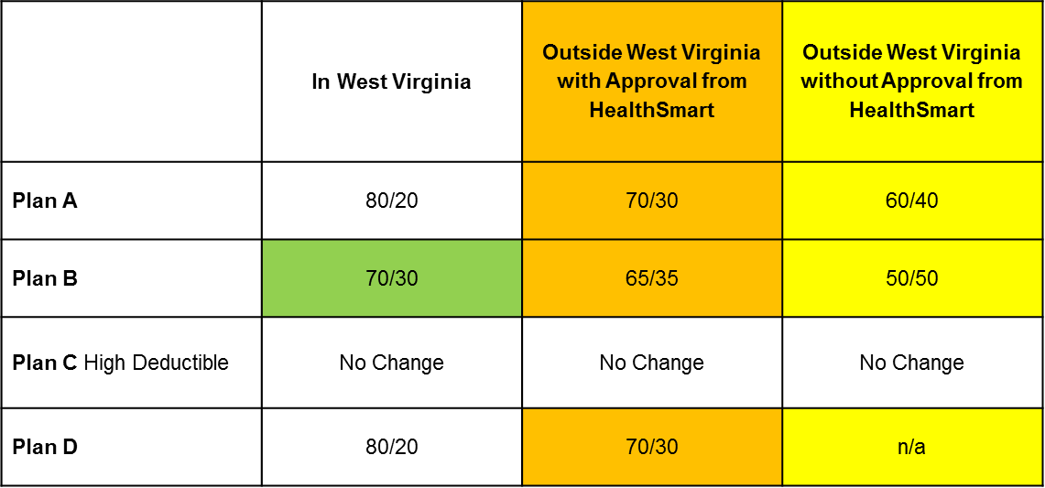
Non-Medicare Retirees
Premium increase 4%
Plan structure changes
This includes network providers in contiguous counties of surrounding states. Members may still use those providers without prior approval, but will pay the higher coinsurance amount for services.
**** Emergencies Included on the higher amount if it is not
pre-certified

Slide 7
Non-Medicare Retirees
    Increase deductible by $100 single/$200 family
    Family out-of-pocket maximum increase Plan A to $3,000 and Plan B to $6,000
    Non-Medicare retiree with Medicare dependents out-of-pocket maximum to $2,700 ($1,500 single out of pocket maximum + $1,200 Medicare out of pocket maximum)

Slide 8
Non-Medicare Retirees,
Active State Employees
and Non-State Employees
Prescription changes:
    Implement mandatory 90-day prescription fill for all maintenance medications
Example 1: Generic: Drug A
Your cost is $20 (2 x $10 copayment for 90 day supply)
Example 2: Preferred brand: Drug B
Your cost is $50 (2 x $25 copayment for 90 day supply)
Example 3: Non-preferred brand: Drug C costs $500 for 90 day supply
Your cost is $500 x .75 = $375
Drugs on the maintenance medication list would not be covered in anything less than a 90-day supply.

Slide 9
MHP and CCP
MHP – Medical Home Program
  encourages members to have a relationship with a primary care physician
  currently MHP office visits have a reduced $10 copay
  This discount ends 7/1/2017
CCP – Comprehensive Care Partnership
  program pairs members with primary care clinics around the state
  CCP members pay reduced or no copayments for specified services at their chosen CCP provider
  CCPs provide primary care, reminders about needed screenings, coordination with specialists, and patient management
  Some CCPs also provide specialist services and labs
CCP Assignments
  Starting March 1, if a member uses a CCP provider more than any other provider, but they haven’t chosen that provider as their CCP, we will be automatically enrolling them as a member of the CCP, unless they opt out.

Slide 10
Active State Employees,
Non-State Employees and Non-Medicare Retirees
All MHP/PCP copayments to $20 (CCP remains the same)

Slide 11
2018 PEIA Healthy Tomorrow’s
Plan Year 2016 - completed
  Employees need to chose a provider on-line or submit a form if they do not have access to the internet.
Plan Year 2017 - completed
  Chose a provider and record measurements.
    Blood Pressure, Glucose, Cholesterol and Waist Circumference
Plan Year 2018 – due by May 15, 2017
  Chose a provider and meet measurement goals or have the waiver box signed by the doctor
    BP <140/90
    Cholesterol <245
    Glucose <125
    Waist Circumference (report only) Men <40,
    Women <35
Additional $500 deductible for non-compliance.

Slide 12
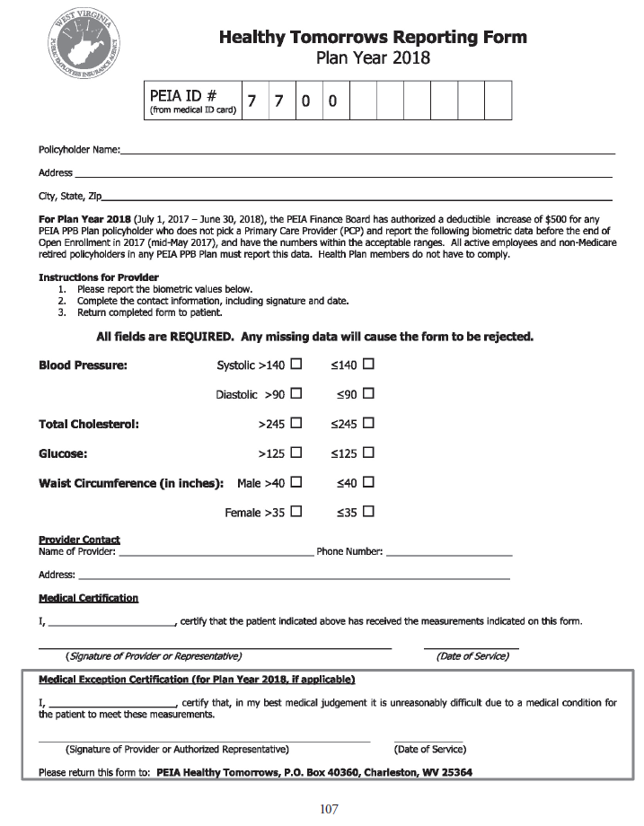

Slide 13
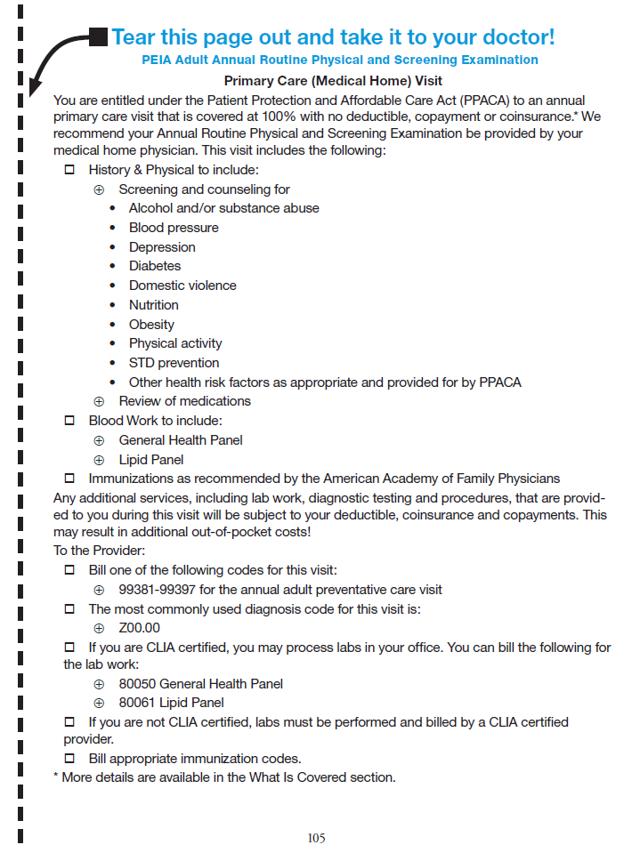

Slide 14
iSelectMD for PPB Members
PEIA signed a contract with iSelectMD to be the PEIA’s preferred telehealth provider for Active members and Non-Medicare members
Members with non-emergent health complaints can call iSelectMD and get a call back from a physician within 30 minutes
iSelectMD physicians treat many non-emergent conditions, including:
  Sinus Infections
  Bronchitis
  Cold & Flu
  Ear Infections
  Urinary Tract Infections
  Gastroenteritis
  Sore Throat
  Pink Eye and much more
iSelectMD physicians can prescribe certain medicines, as needed

Slide 15
iSelectMD
Services
  For consultation with a Board Certified Physician call
  1-877-775-3006.
  WV Code is: WV144
  iSelectMD is available anytime and anywhere
  iSelectMD encourages everyone to have a primary care physician and does not replace an existing primary care physician.
  iSelectMD requires a Medical History Disclosure to be completed prior to the first consultation. This may be completed online at www.iselectmd.com or by calling customer care at 1-877-775-3006 x3.
  Depending on time of day or call volume, iSelectMD physicians dedicate themselves to return calls within 30 minutes from the time they receive the request.
Prescriptions
  iSelectMD physicians reserve the right to write prescriptions when deemed appropriate and do not prescribe DEA controlled substances or certain other drugs that may be harmful due to potential abuse.

Slide 16
PEIA partners with iSelectMD
With just one simple phone call, members are connected to state-licensed, board-certified physicians who are ready to resolve non-emergency health issues 24 hours a day for a $40 copay. iSelectMD physicians will take the time to listen and consult with you to recommend a treatment plan and, when appropriate, prescribe medication.
iSelectMD is for PEIA PPB Plan Non-Medicare and/or Active members only.
Contact Information
To learn more, visit iSelectMD.com or call 1-877-775-3006.

Slide 17
Rx Savings Solutions
New service is available April 1, 2017
Website that members can use to save money on prescriptions
Rx Savings Solutions tracks prescription prices by pharmacy, and can let members know when they can save money by choosing a different pharmacy.
The software analyzes data to find lower cost alternative drugs that could save the member money.

Slide 18
Rx Savings Solutions is…
Easy
  Clear cost comparisons
  Basic healthcare terms
  Phone, email or text notifications
  Certified pharmacy tech support
Safe
  Pharmacist designed and validated
  Clinically trustworthy
  HIPAA-compliant
  Drug interaction awareness
This service is available to members in PEIA PPB Plans A, B, C and D and the Special Medicare Plan.

Slide 19
Medical Benefit Changes
Active State Employees and Non-State Employees and Non-Medicare Retirees.
Increase the number of outpatient procedures subject to Facility Fee Limits. If the member chooses an out-of-state facility that charges more than the PEIA facility fee limit, the member will be responsible for the difference between PEIA’s payment and the facility’s charge.
This will include bordering Counties.

Slide 20
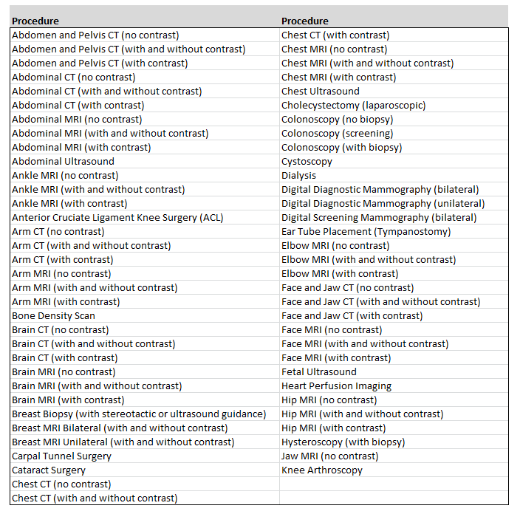
Increase the number of outpatient procedures subject to maximum facility fees

Slide 21
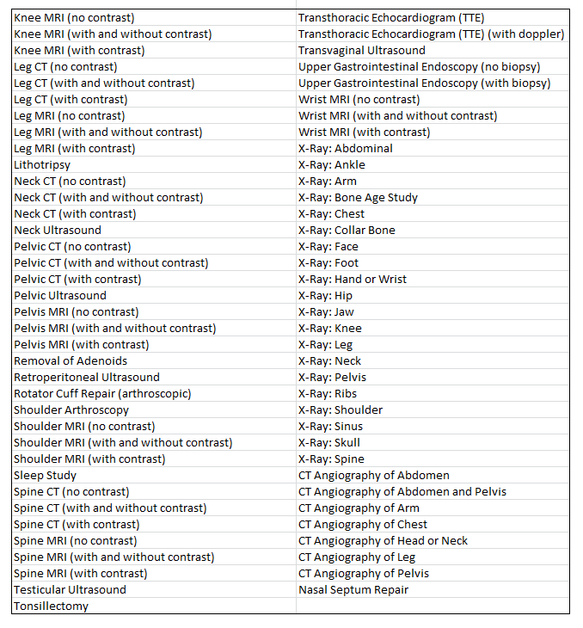

Slide 22
Benefit Fairs PY 2018
Date | Time | Seating | City | Location
4/5/2017 | 3-7pm |  | Morgantown | Ramada Inn 20 Scott Ave
4/6/2017 | 3-7pm |  | Martinsburg | Holiday Inn 301 Foxcroft Ave.
4/11/2017 | 3-6PM |  | Charleston | Holiday Inn Express 100 Civic Center Dr.
4/12/2017 | 3-7pm |  | Beckley | Tamarack 1 Tamarack Park
4/13/2017 | 3-7pm |  | Huntington | Holiday Inn 800 3rd Ave
4/18/2017 | 3-7pm |  | Parkersburg | Comfort Suites 167 Elizabeth Pike
4/19/2017 | 3-7pm |  | Wheeling | WV Northern Community College

Slide 23


Slide 24


Slide 26
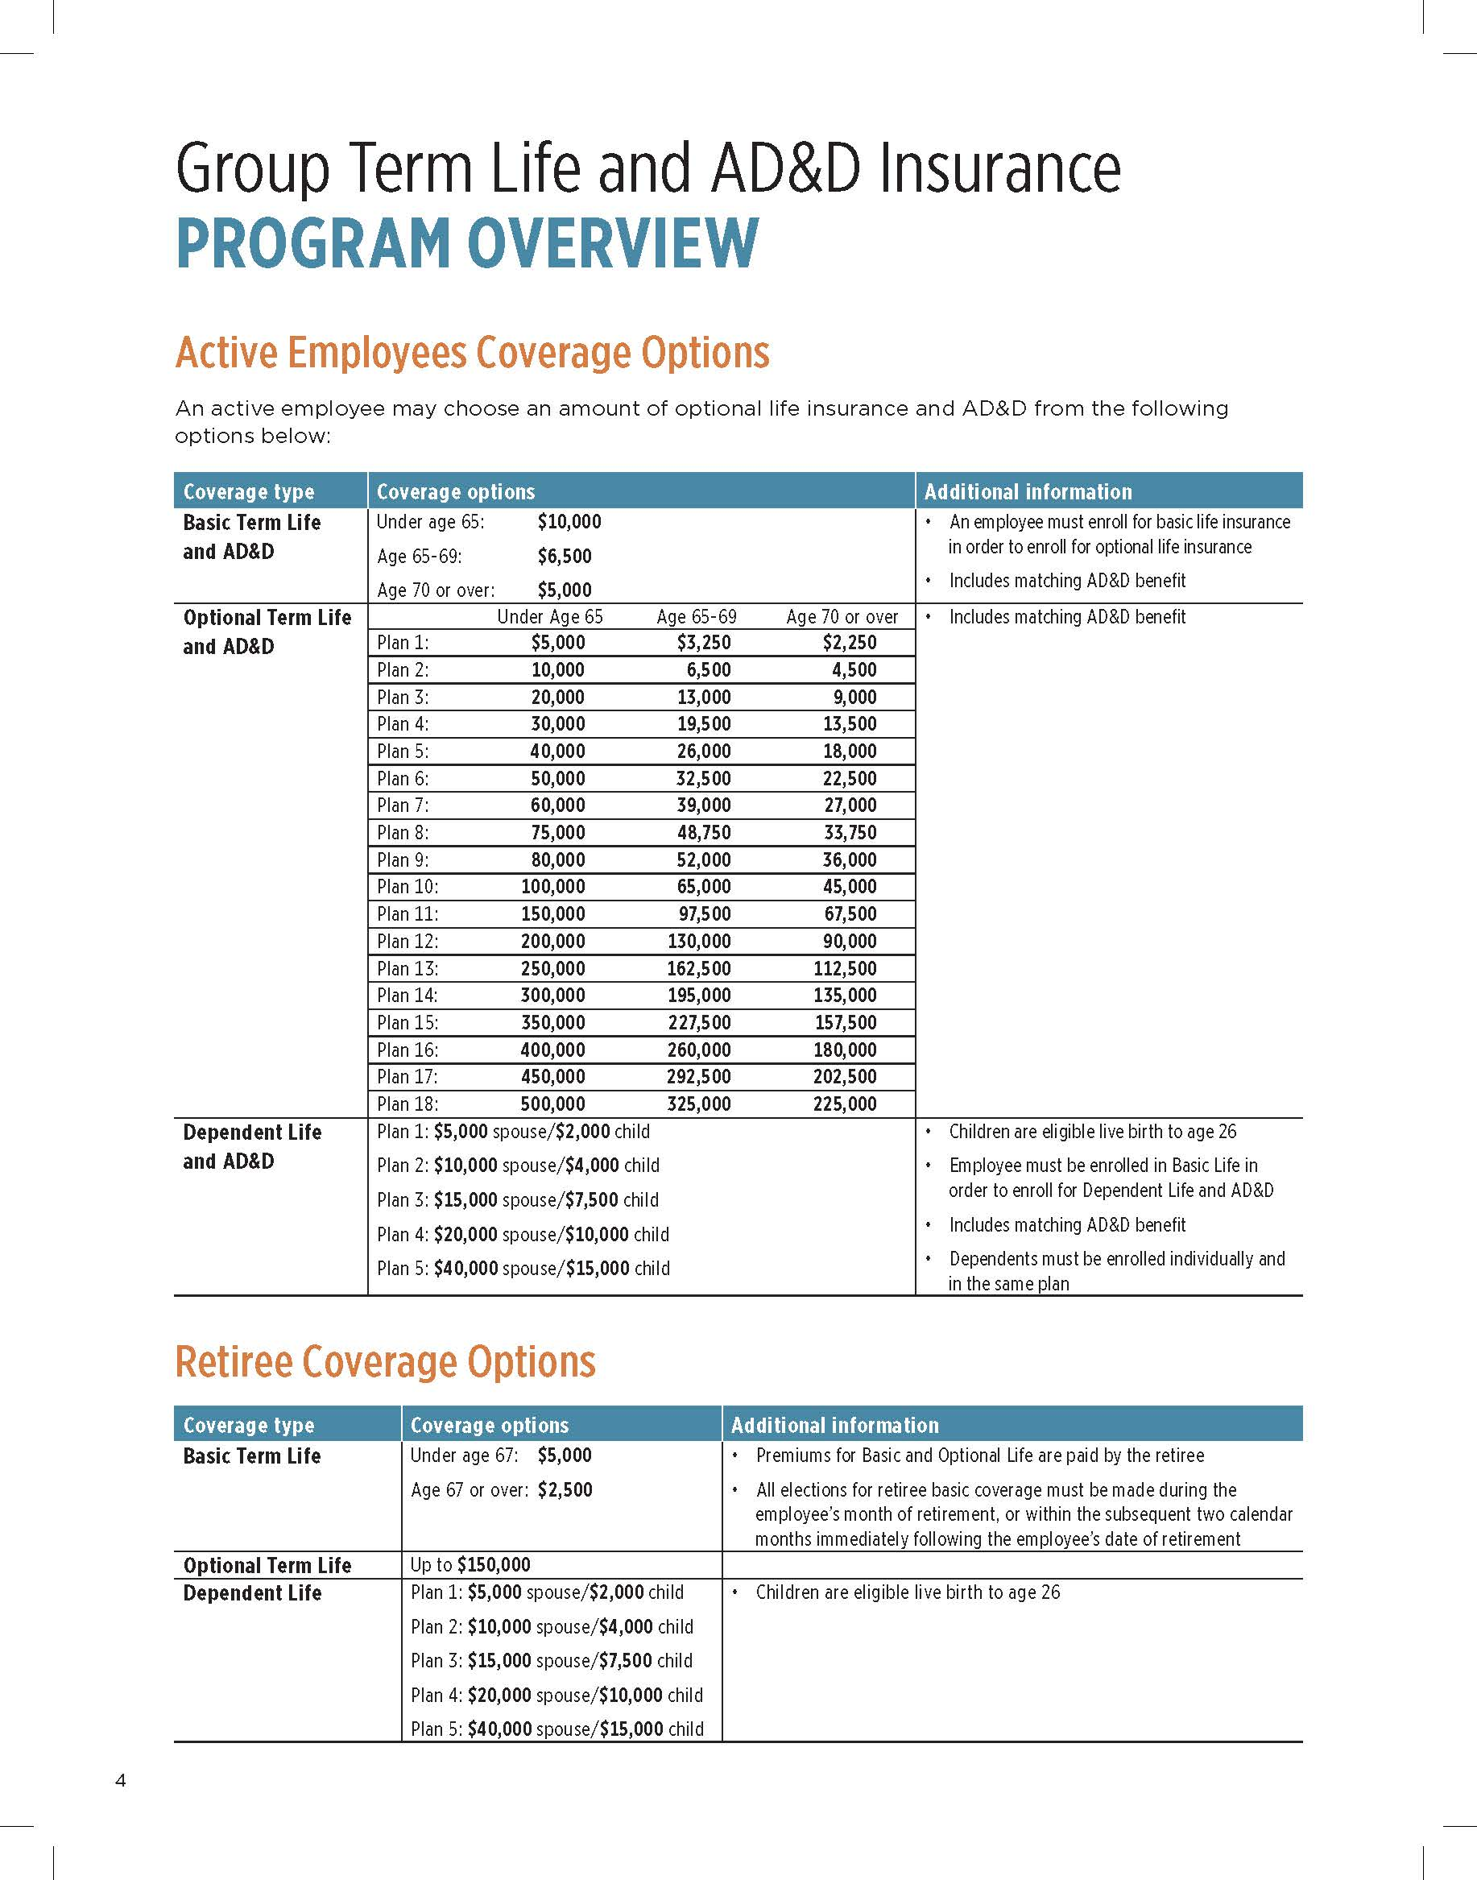

Slide 27
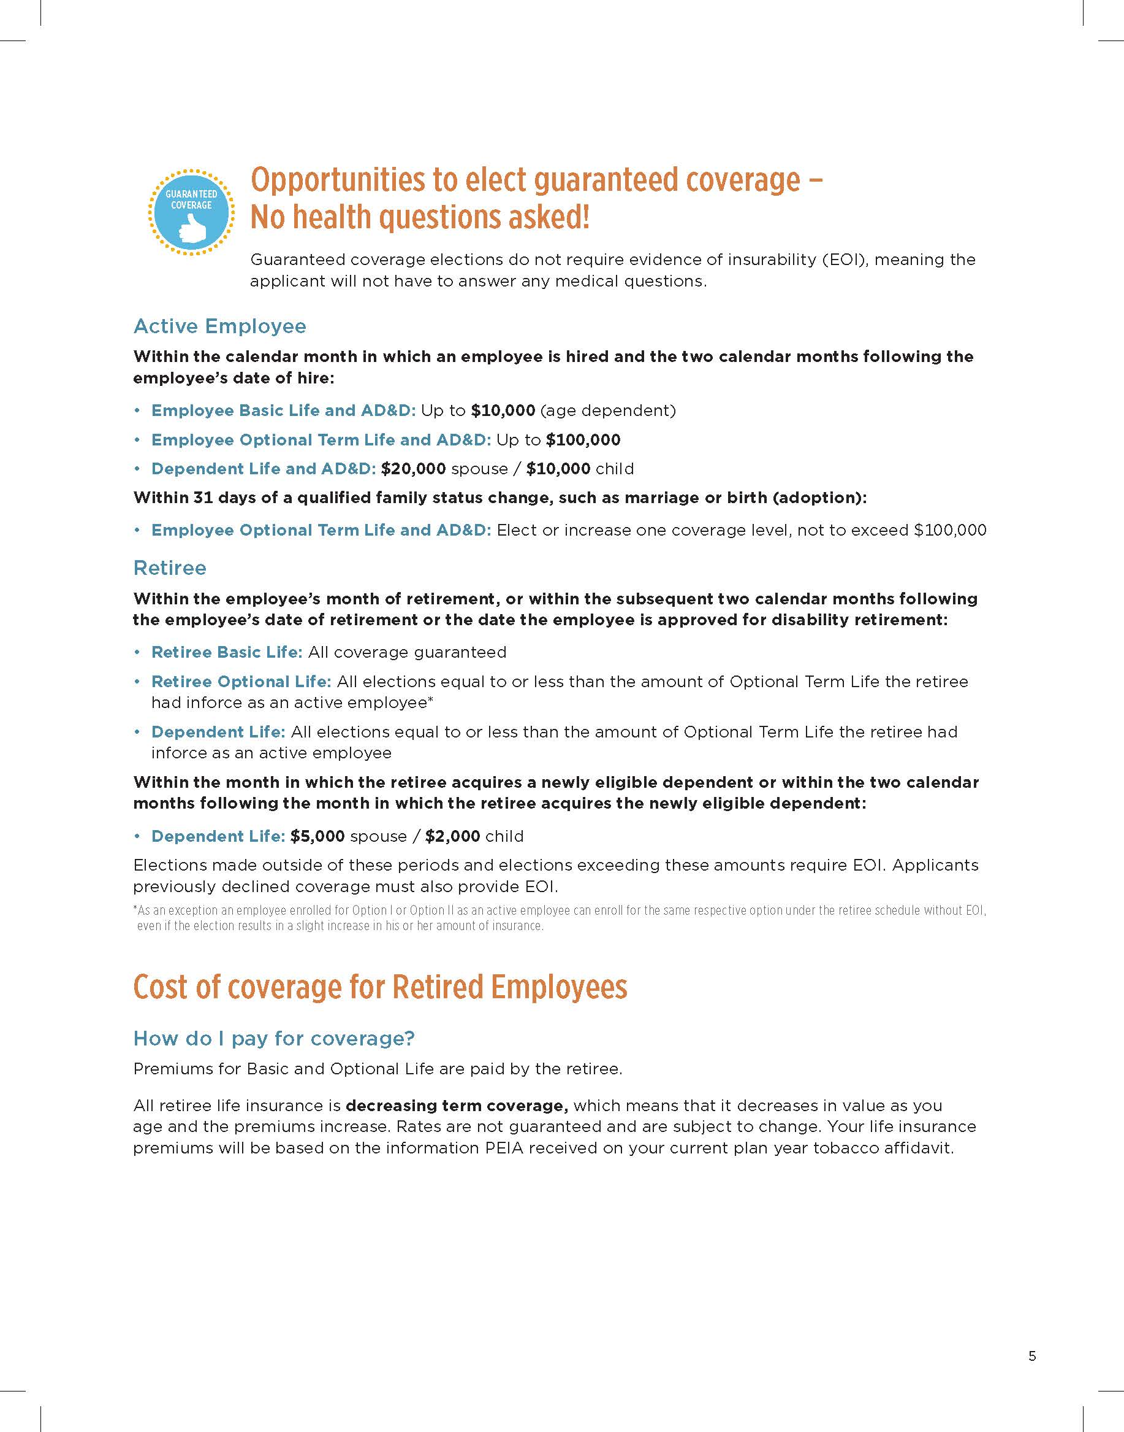

Slide 29
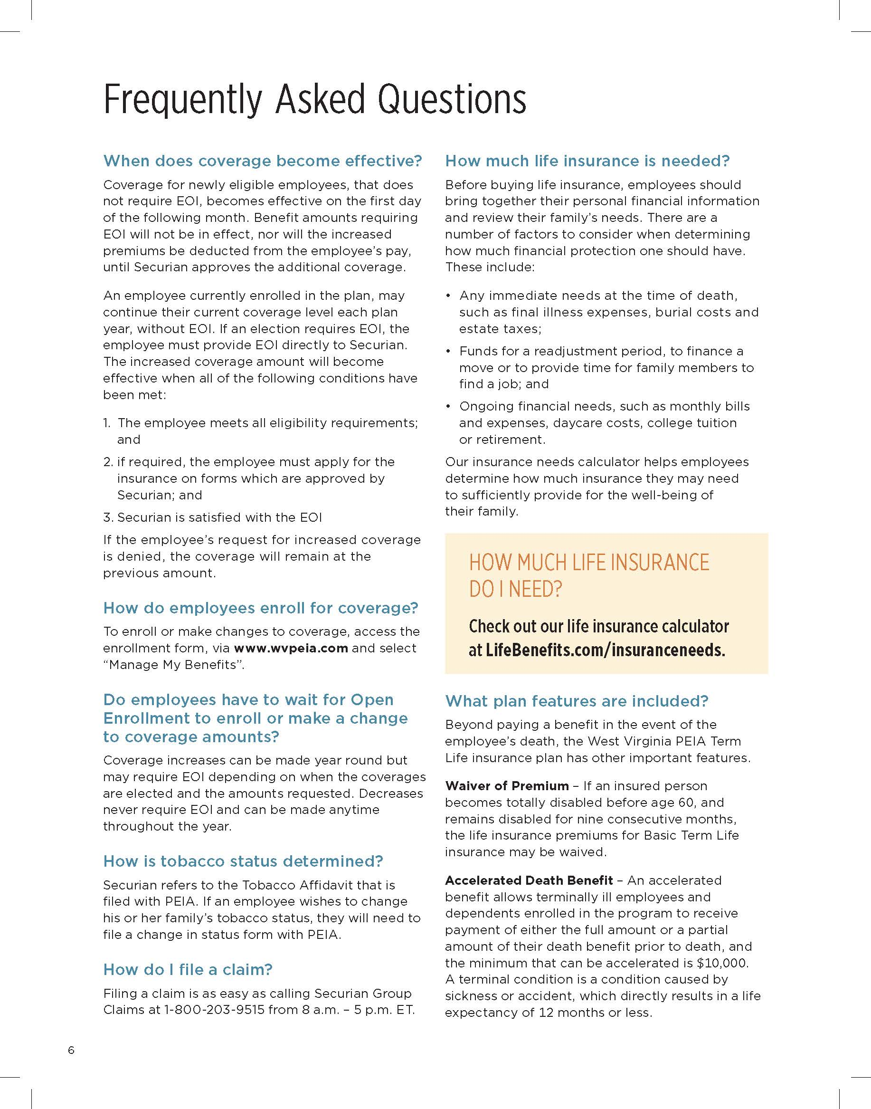

Slide 31
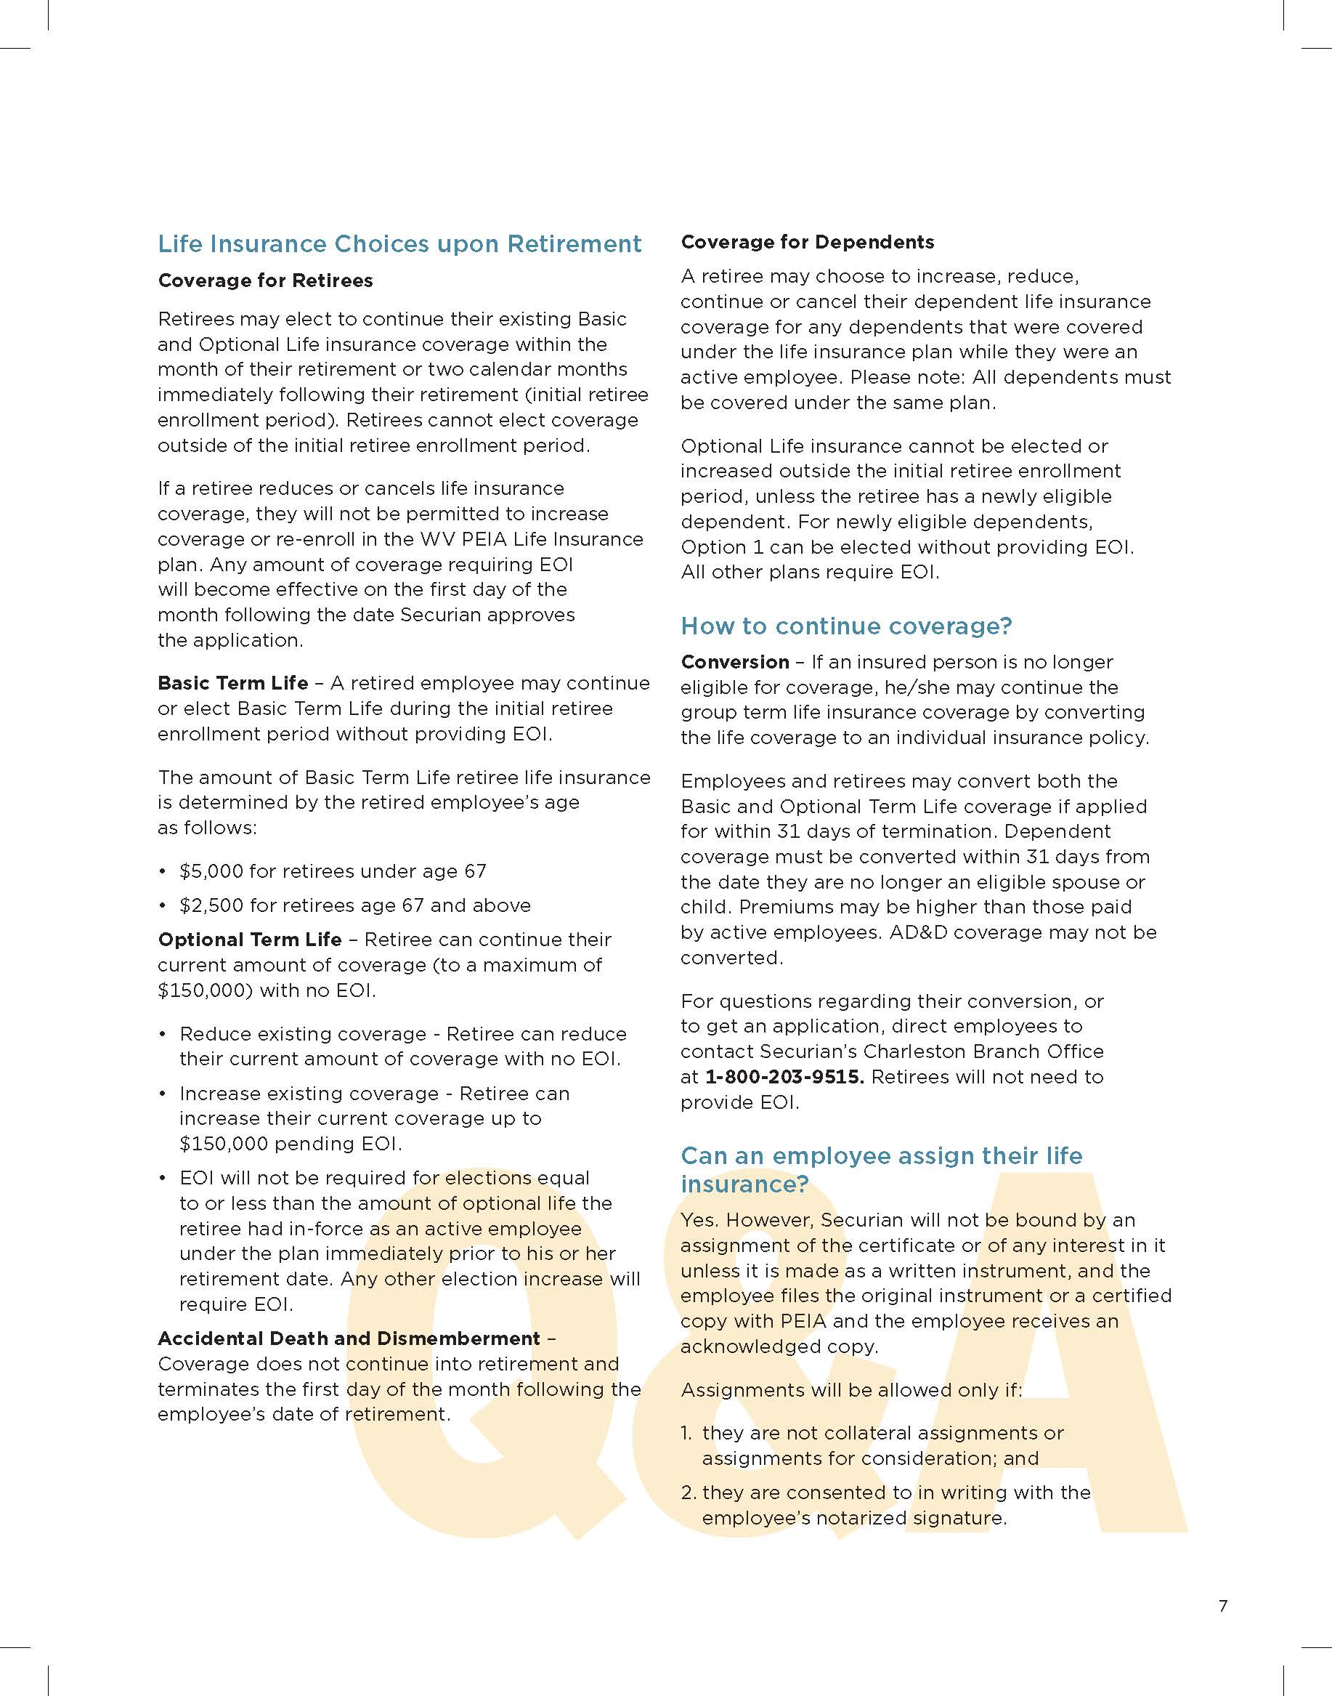

Slide 32
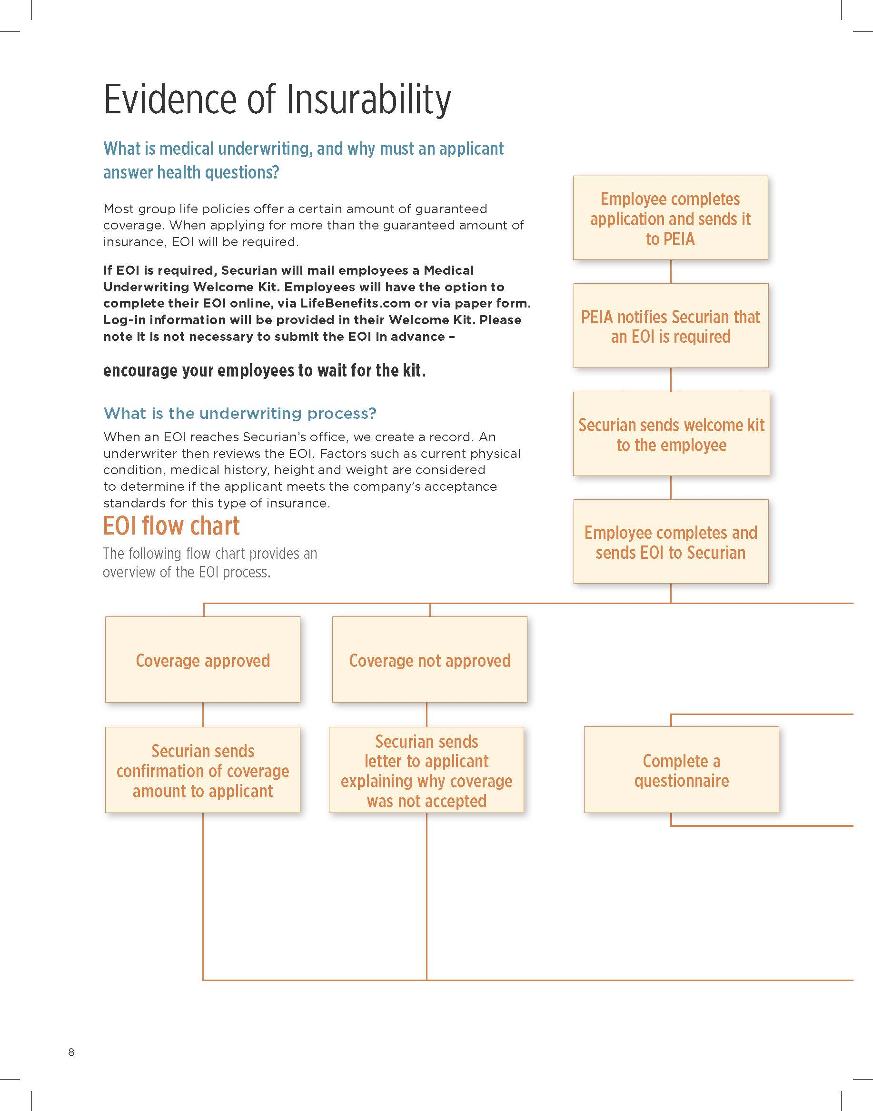

Slide 33
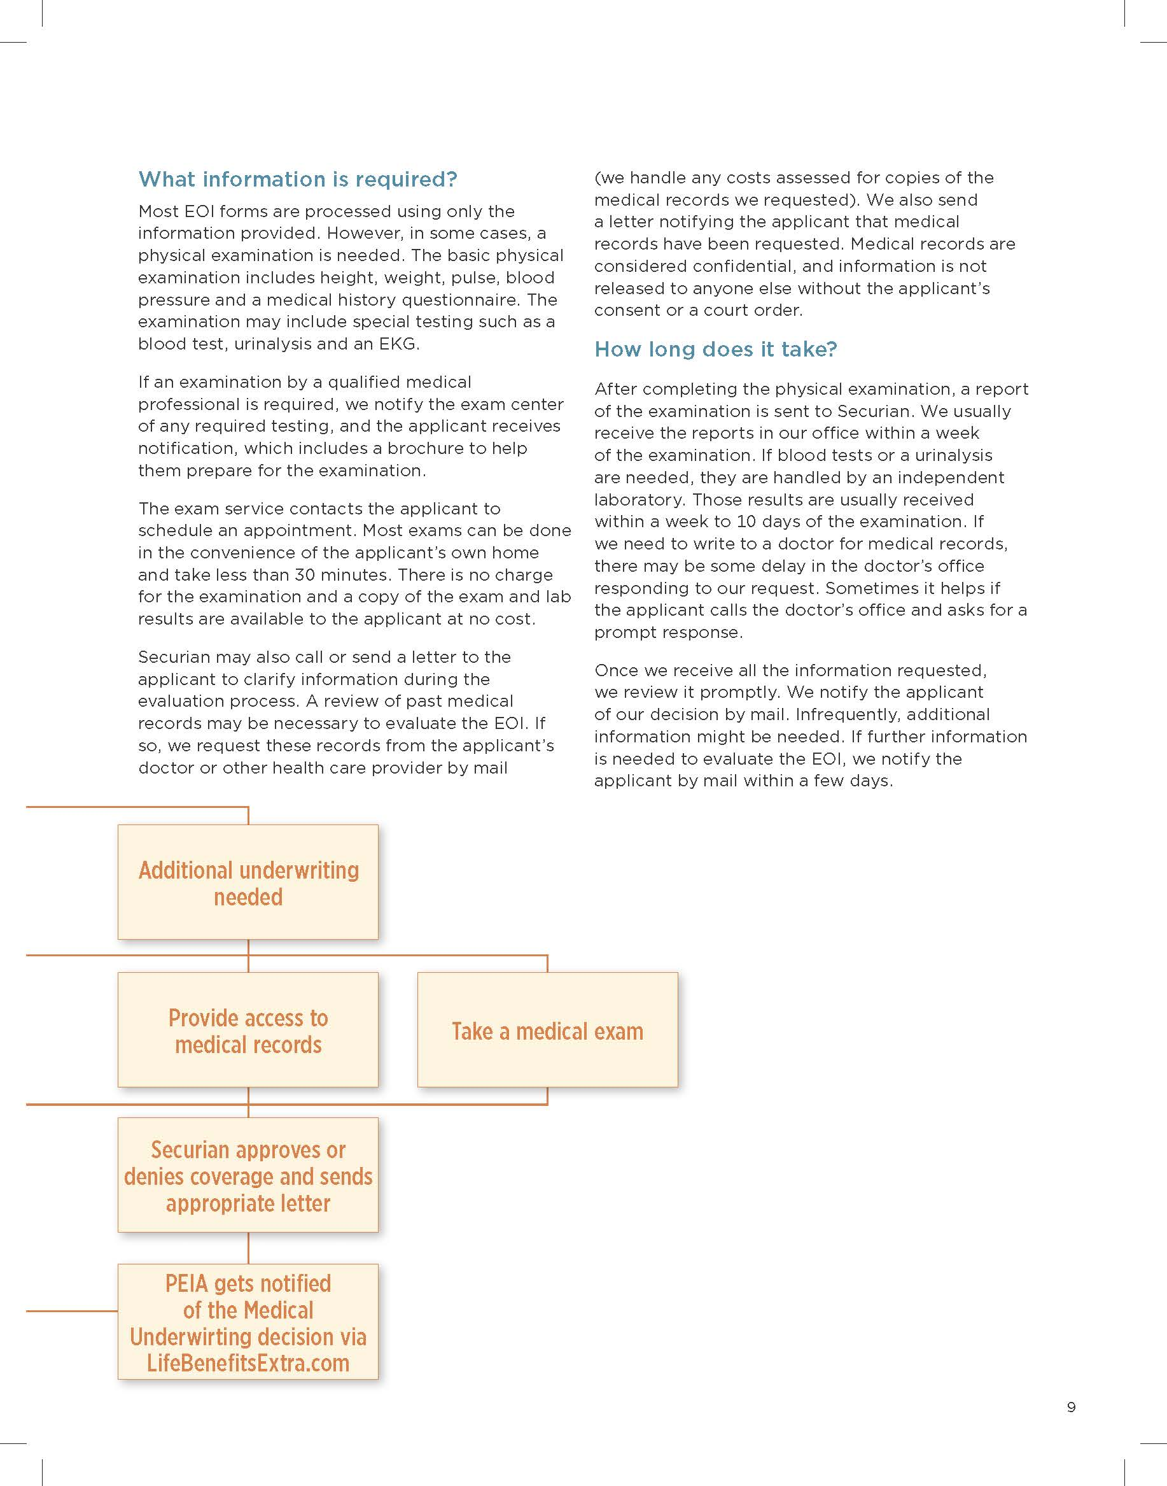

Slide 34
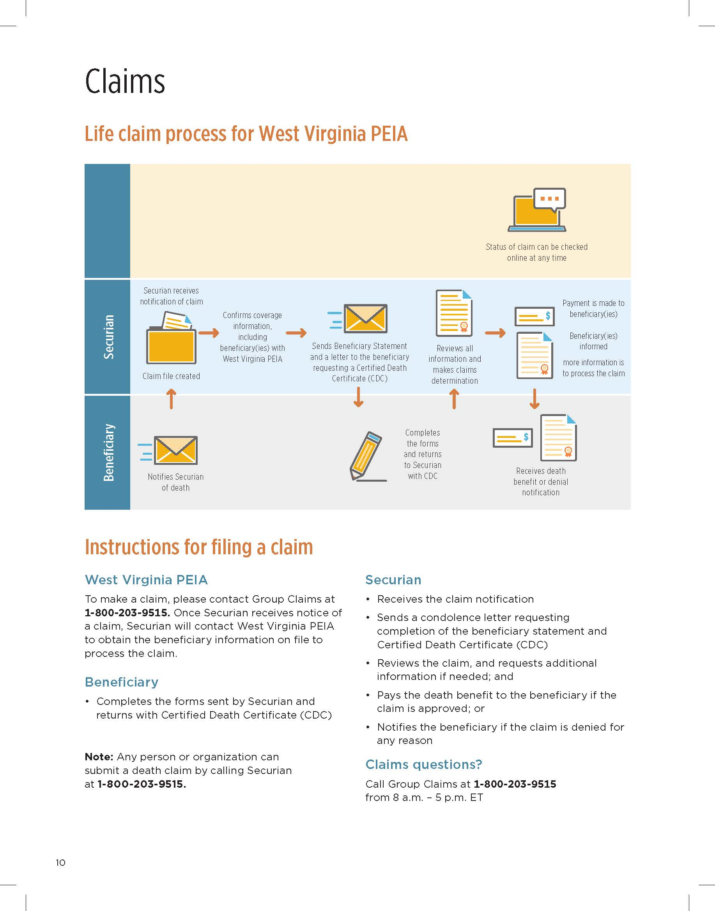

Slide 36
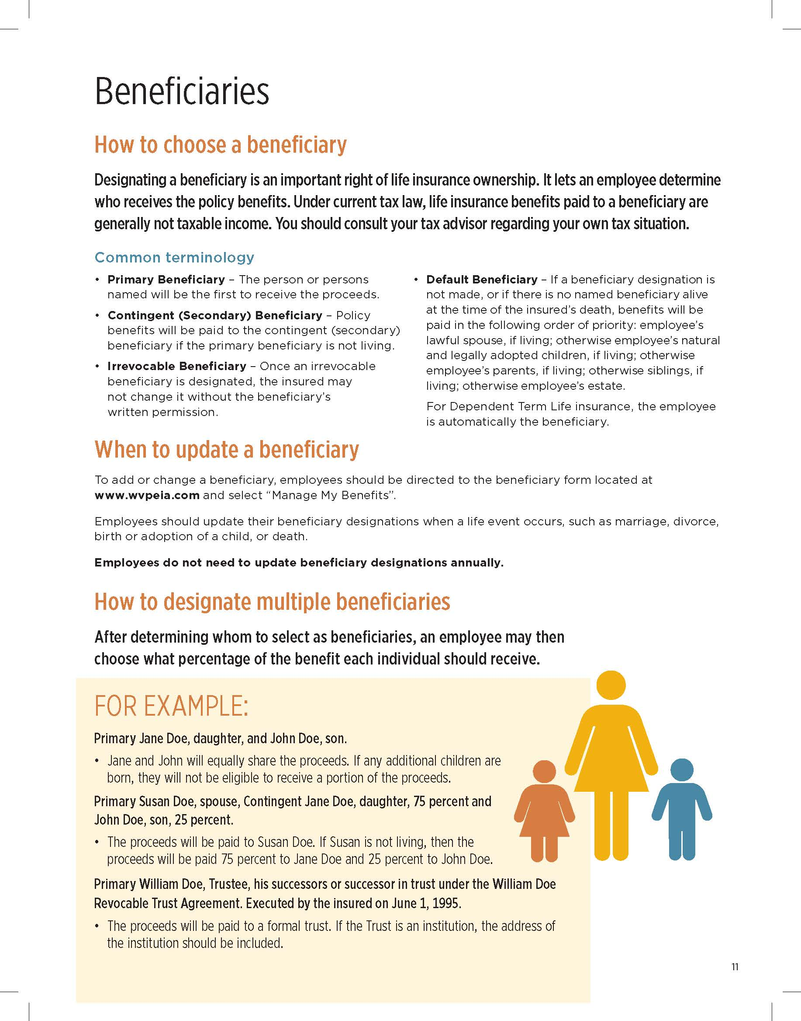

Slide 38
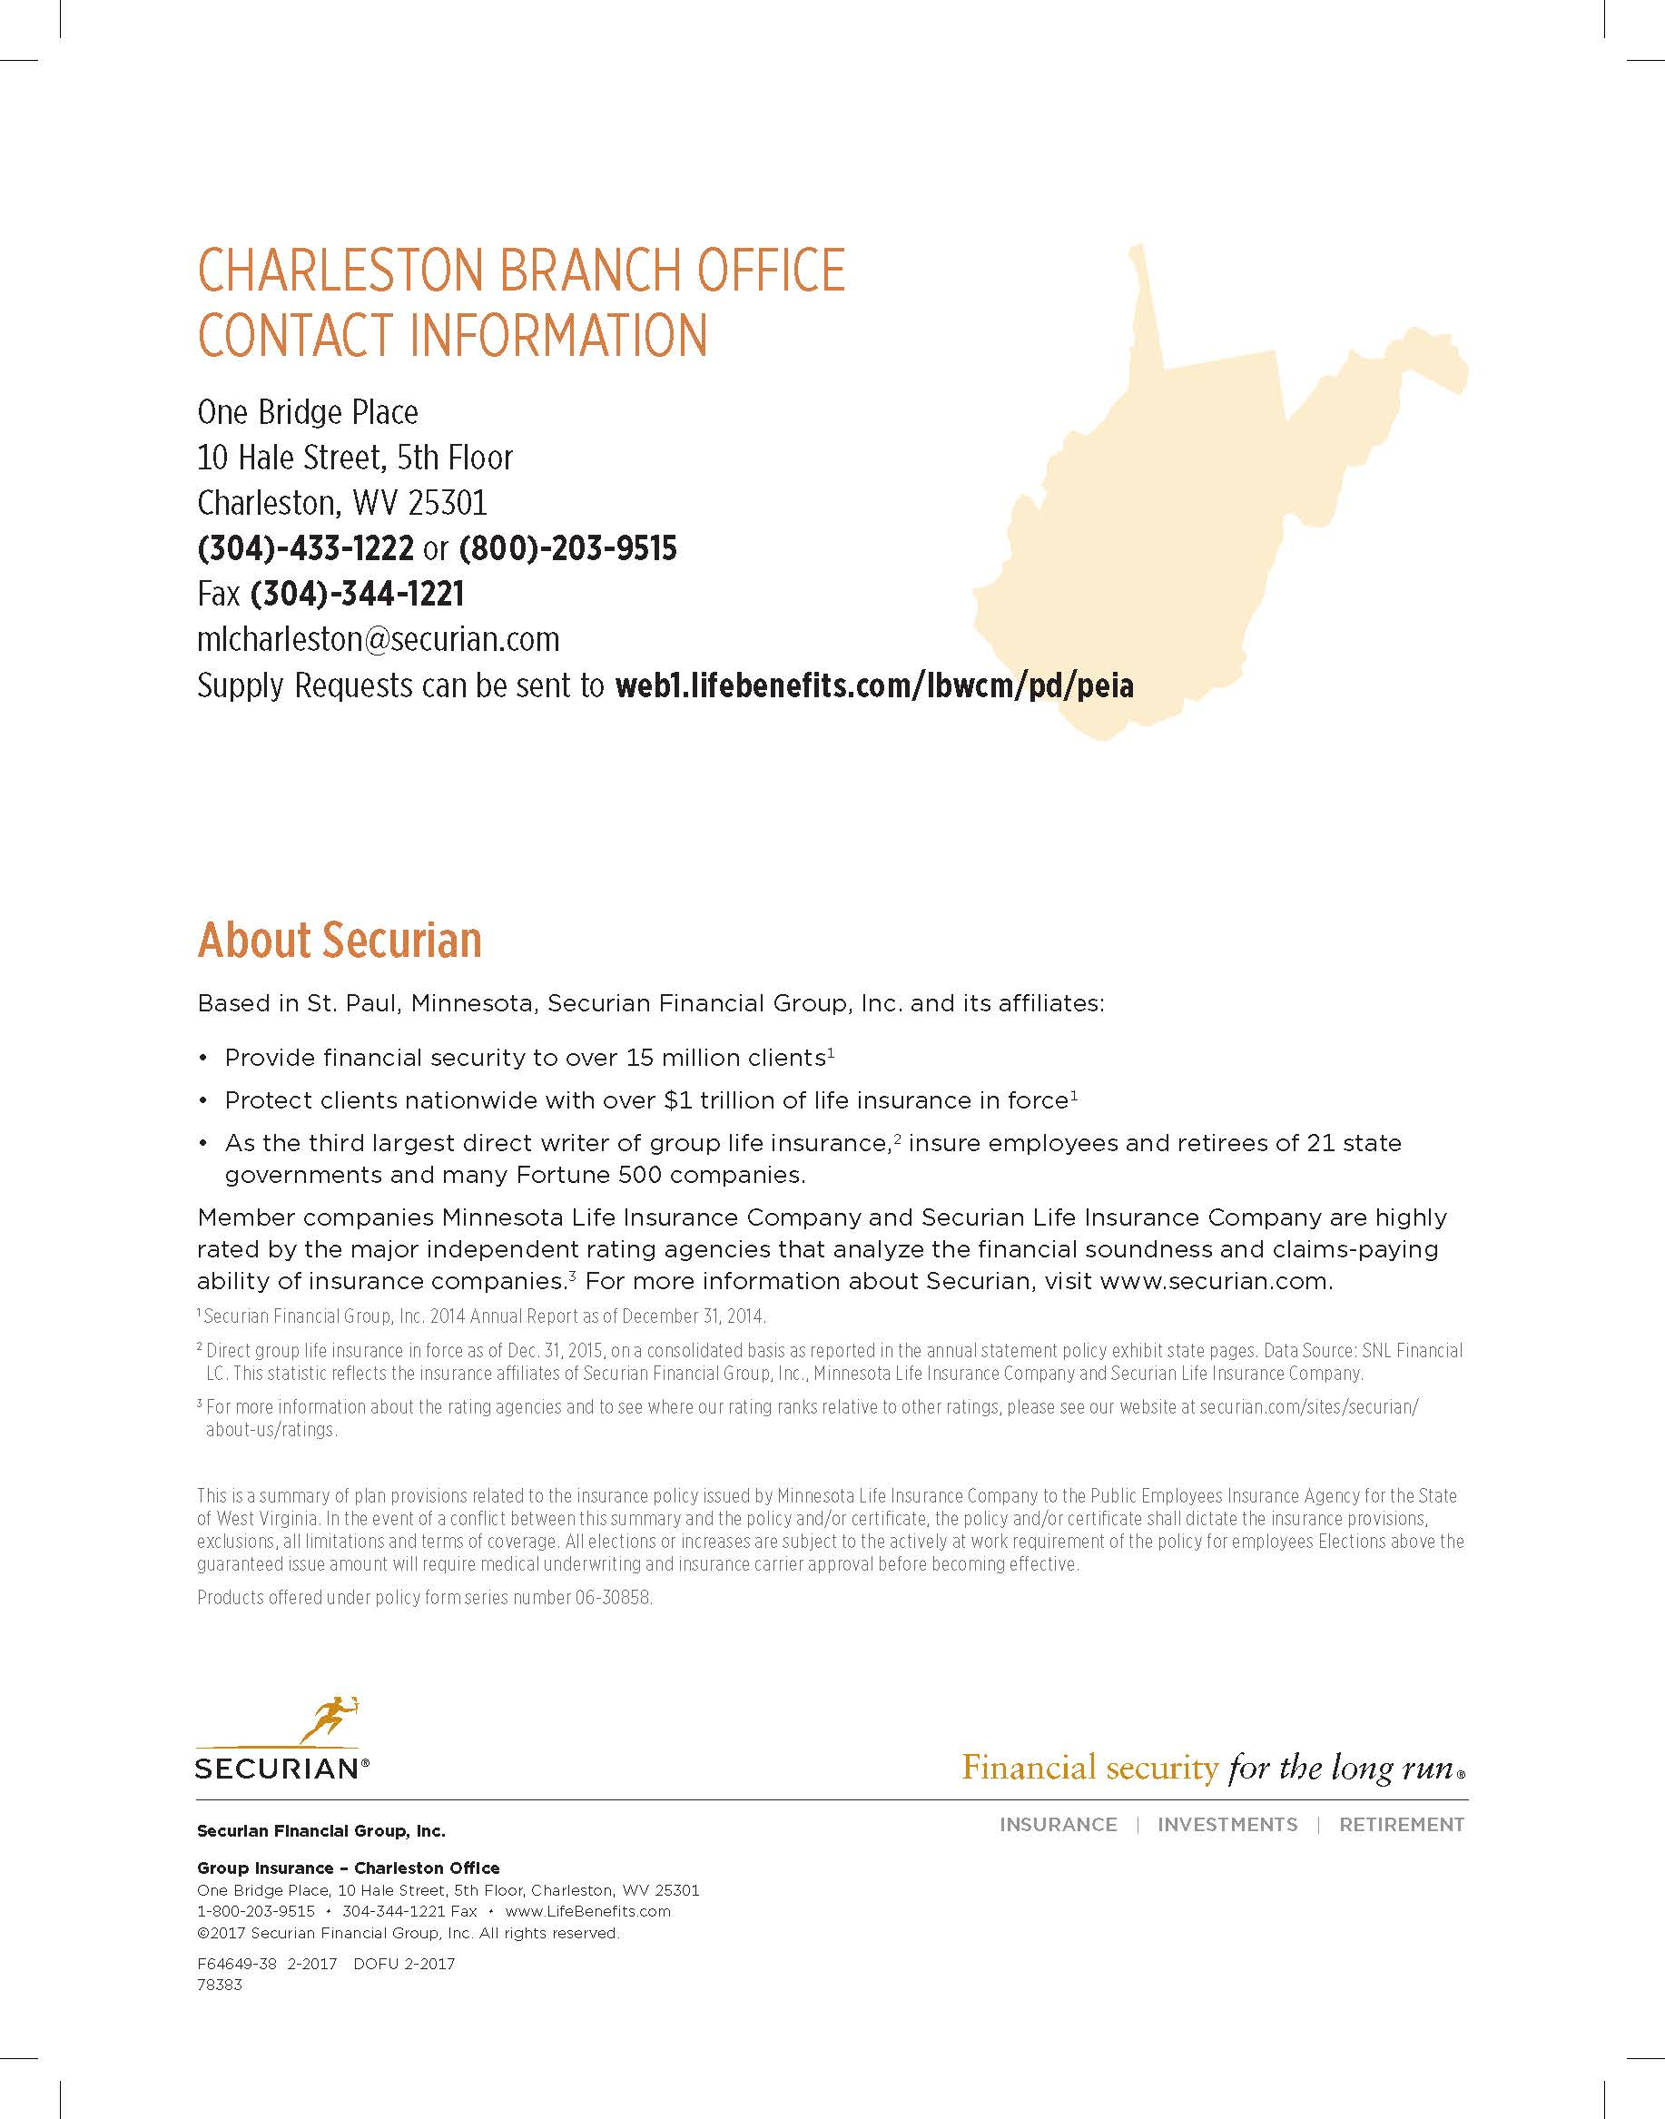

Slide 40

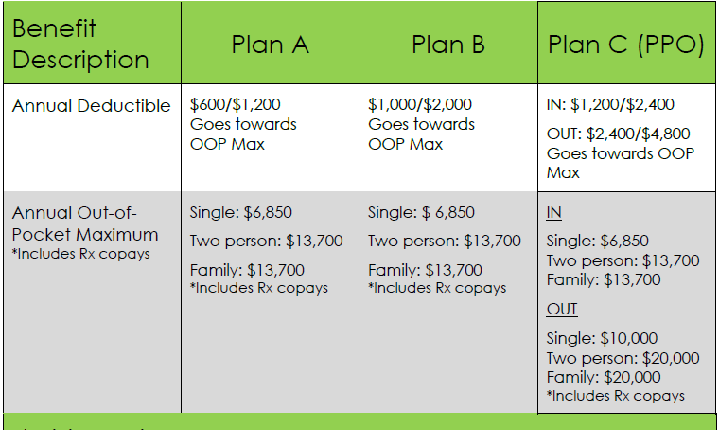


Slide 41


Benefit Coordinator Open Enrollment Training

Slide 42

Open Enrollment
Open Enrollment Dates:
April 2, 2017 – May 15, 2017
Changes Only Enrollment
Enroll online via Premier Enroll at MyFBMC.com or via FBMC paper enrollment form
Benefit effective date July 1, 2017

Slide 43
Mountaineer Flexible Benefits
Dental
Vision
Short-Term Disability
Long-Term Disability
Hearing Plan
Legal Plan
Flexible Spending Accounts (Health Care & Dependent Care)
** DCFSA: Coverage extends to age 13, unless disabled
Health Savings Account (HSA) (Must be enrolled in PEIA Plan C)
Limited Health Care FSA (Must be enrolled in HSA)

Slide 44
What’s New for Plan Year 2018
This is a Changes Only enrollment. If you do not make changes, your benefits will roll over and your premiums will be adjusted to reflect any new rates.
The dental rates for the Routine and Assistance Plans are slightly increasing. The Basic and Enhanced Plans are remaining the same.
The Hearing Plan rates are slightly increasing and the benefit allowance is now $500 per ear per device.
The Health Care FSA, Dependent Care FSA, Health Savings Account and Limited Health Care FSA are now administered by PayFlex.

Slide 45
What’s New for Plan Year 2018 (cont.)
The Health Care FSA & Limited Health Care FSA minimum annual contribution is now $150 and the maximum annual contribution increased to $2,600.
Mountaineer Flexible Benefits will maintain the grace and run-out period, in lieu of a $500 rollover.
Individual HSA contribution limit is $3,400 per year.
The HSA custodian fee will decrease to $2.50.
Employees should exhaust their FSA balance with WageWorks by the end of the grace period (September 15, 2017).

Slide 46
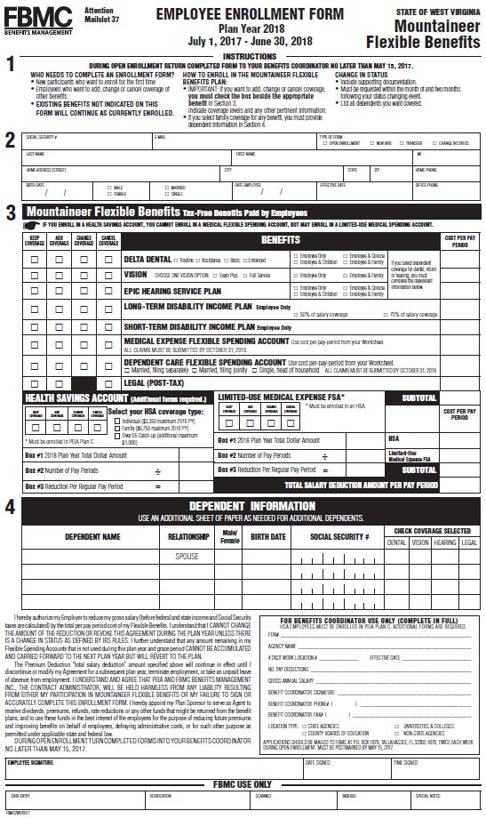
Enrollment Form
Open Enrollment
New Hire
Transfer
Change in Status

Slide 47

Transfers
When an employee transfers, it is the employee’s responsibility to provide their current benefits to the new agency. At that point the BC for the new agency is responsible for starting payroll deductions for the new employee.
  In the event that the new employee is unsure of his or her current benefits, the employee needs to contact the old agency, contact FBMC’s service center or log in to www.myFBMC.com to confirm coverage.
  New benefit coordinator needs to have the employee submit an enrollment form, mark it transfer, and all coverage’s must remain the same.
Notes:
FBMC currently has 134 employees. As with any successful business, employees are a key element to success. At FBMC, we embrace that culture and have selected an executive and management team that has dedicated their professional careers to benefits administration, technology and government service. This experience enables our team to have a thorough understanding of the services requested by our Clients and to deliver superior solutions. The average tenure of our team members exceeds 10 years of service. Our goal is to serve as an extension of our Client’s Human Resources and Benefits Teams. FBMC employees are dedicated to providing excellent service to our clients in a manner that exceeds their expectations

Slide 48
Change In Status
Employees now have the month of and two months following a qualifying event to submit a change in status form
Must include supporting documentation
Benefit Coordinators will receive confirmation of approval or denial from FBMC via fax

Slide 49
Terminating Benefits
State Agencies/Universities & Colleges:
  Notify FBMC via the payroll system (OASIS, EPICS, etc.) if an EE is terming, retiring or going on LOA.
Non-States & Boards of Education:
  Notify FBMC via the fillable adjustment form if an EE is terming, retiring or going on LOA .

Slide 50
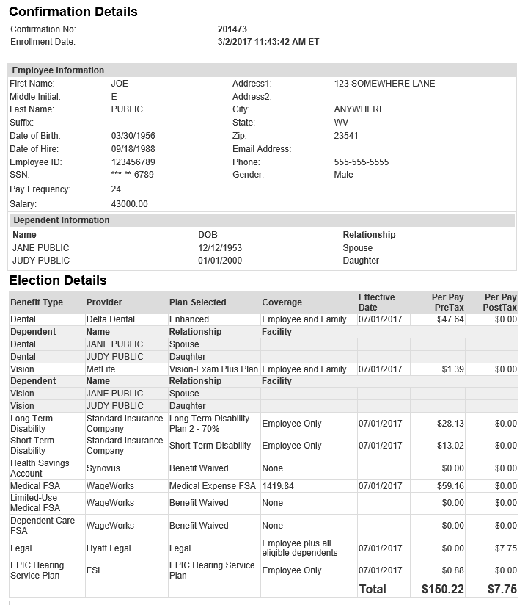
Online Enrollment Confirmation Statement

Slide 51
Things to Remember
Reminder Boards of Education and Non-State agencies need to provide salary information to Marilyn Padgett for employees that have had a salary change within the last 12 months
Complete Benefit Coordinator section of enrollment form in its entirety for ALL enrollment forms
Provide Enrollment Forms to FBMC twice a week. Mark the last shipment of forms as ‘Final Batch”
All enrollment forms must be postmarked by May 20th
Non-State agencies will receive enrollment packets and be responsible for distributing enrollment materials to their employees
Pay period designations for the Final OASIS Wave may convert from 24-pay to 26-pay during the plan year

Slide 52
Contact Information
FBMC Service Center
1-844-55-WVA4U (1-844-559-8248)
Kayla Horton Khorton@fbmc.com 304-558-7850 Ext. 52627
Items related to issue resolution, notification of any BC changes & employer access to fbmc.com
Emily Hoffman Ehoffman@fbmc.com 304-558-7850 Ext. 52652
Items related to escalated issue resolution

Slide 53
Contact Information (cont.)
Marilyn Padgett mpadgett@fbmc.com
Items related to payroll if you are a State or University/College
Robert Jackewich rjackewich@fbmc.com
Items related to payroll if you are a Non-State or BOE
Kimberly Christie kchristie@fbmc.com
Items related to approval/denial of Change in Status requests
Please advise your employees to contact the FBMC Service Center with any questions. Do not give your employees FBMCs direct contacts listed above.

Slide 54
Important Fax Information
Active Employees
  Fax # 850-514-5803 ATTN: Enrollment Processing
  New hires, transfers, demographic changes, etc.
Change in Status
  Fax # 850-514-5803 ATTN: Change in Status
  **Please include supporting documentation along with initial form submission
Enrollment Appeals
    Fax # 850-425-6220 ATTN: Appeals
Retirees
  Fax # 866-836-9943 ATTN: Direct Bill

Slide 55

Open Discussion

