Slide 1

West Virginia Retiree Health Benefit Trust Fund
and
PEIA Finance Board Meeting
Thursday, March 16, 2017, 1:00 p.m.
Canaan Valley Room 1041, DEP Building, 601 57th Street, SE
Charleston, WV 25304

Slide 2
Agenda
Roll Call
Call to Order
Approval of Minutes
Financial Plan Updates
Premium Discussion
Public Comments
Motion to Accept Discussed Items
Director Update
Old Business
New Business
Next Meeting – June 15, 2017

Slide 3
Roll Call
John Myers, Chairman
Members:
          James W. Dailey, II
          Brian Donat
          Troy Giatras
          Elaine Harris
          William “Bill” Ihlenfeld
          William “Bill” Milam
          Michael T. Smith
          Joshua Sword
          Philip Reale, II

Slide 4

            Approval of Minutes
            December 1, 2016
John Myers
Chairman

Slide 5

Financial Plan Update
Chris Borcik and Dave Bond, Continuing Care Actuaries
Jason Haught, CFO, PEIA
PEIA/RHBT Finance Board Meeting
5

Slide 6
PEIA/RHBT Finance Board Meeting
6

Slide 7
PEIA/RHBT Finance Board Meeting
7

Slide 8
Financial Statements Year to Date
January 2017 Financial Statements
  PRESENTED BY: Jason Haught, CFO, PEIA

Slide 9
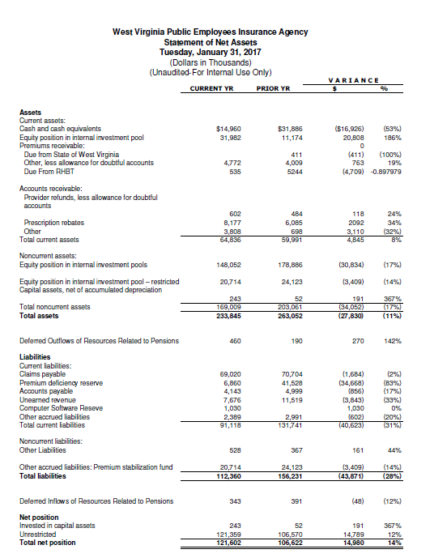

Slide 10
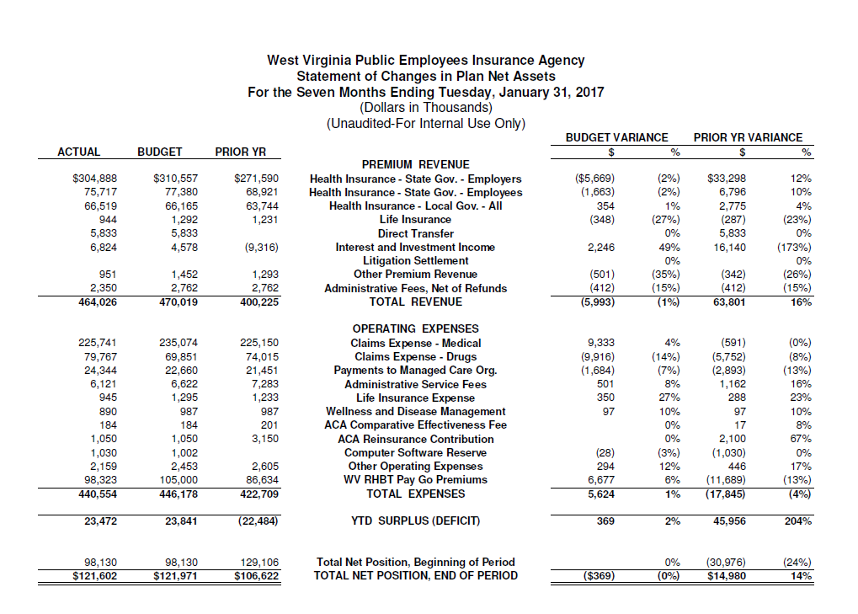

Slide 11
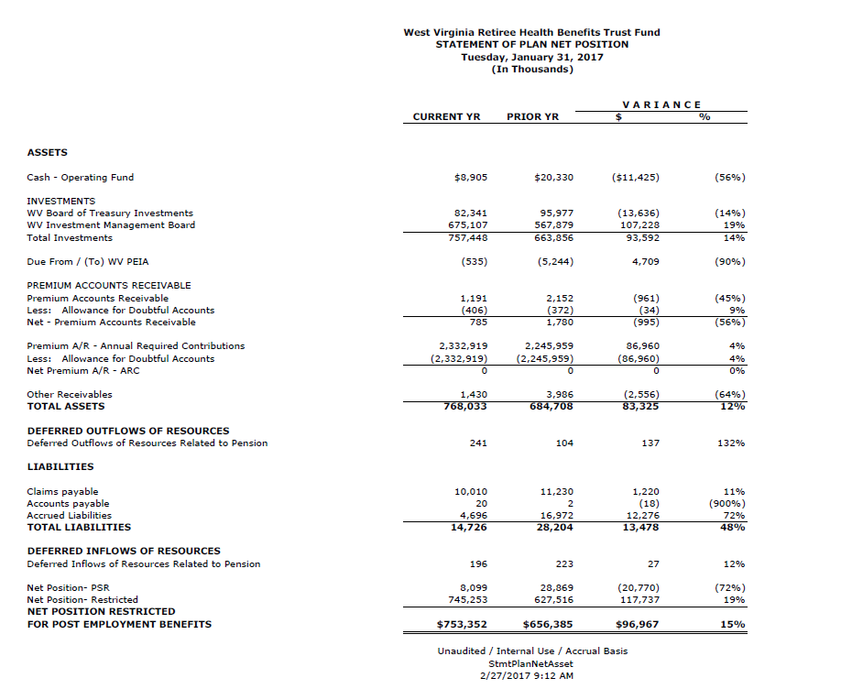

Slide 12
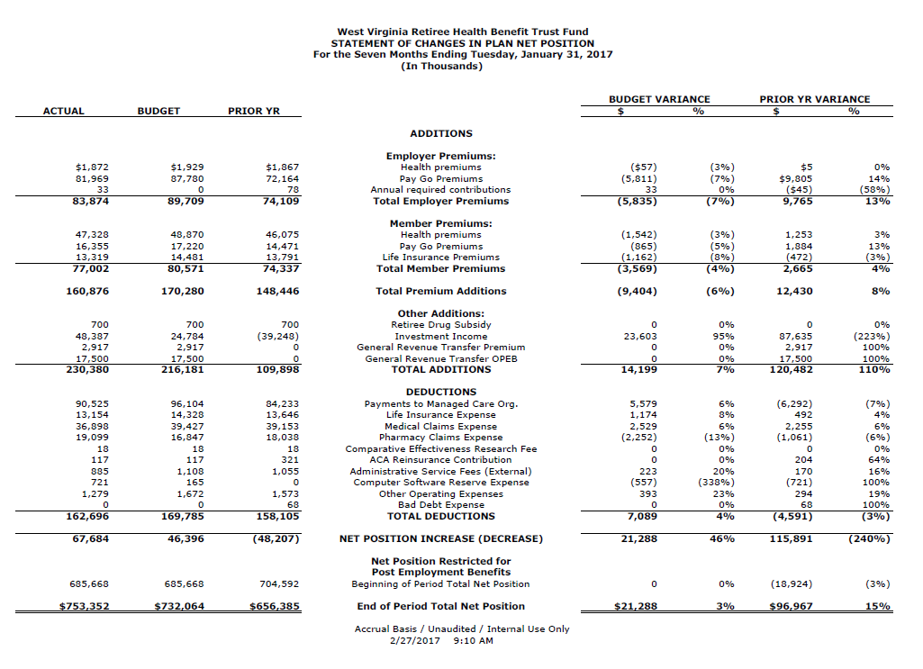

Slide 13
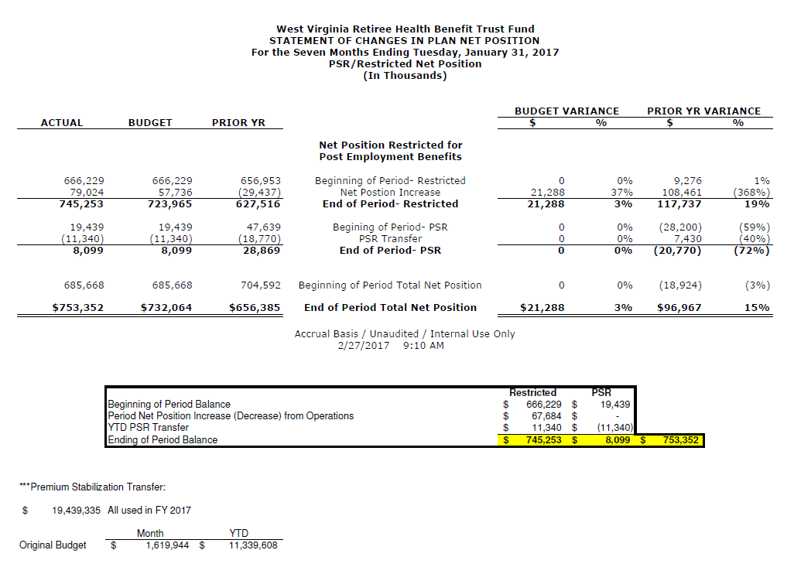

Slide 14
PREMIUM Discussion
By: Jason Haught, CFO, PEIA
PEIA/RHBT Finance Board Meeting
14

Slide 15
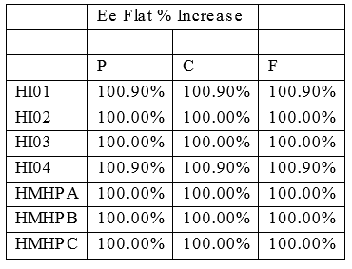

Slide 17
 | All Plans
 |  |  | Dec-14 | Dec-15 | Dec-16
Salary | Salary Code | Tier | Count | Count | Count | Difference
$0-$20,000 | 1 | P | 934 | 937 | 975 | 38
 | 1 | C | 192 | 170 | 177 | 7
 | 1 | F | 763 | 750 | 839 | 89
$20,001-$30,000 | 2 | P | 7,054 | 6,934 | 6,956 | 22
 | 2 | C | 2,067 | 1,938 | 1,857 | -81
 | 2 | F | 9,076 | 8,542 | 8,259 | -283
$30,001-$36,000 | 3 | P | 3,577 | 3,638 | 3,780 | 142
 | 3 | C | 852 | 850 | 835 | -15
 | 3 | F | 4,348 | 4,491 | 4,368 | -123
$36,001-$42,000 | 4 | P | 3,757 | 3,728 | 3,613 | -115
 | 4 | C | 1,035 | 1,119 | 1,137 | 18
 | 4 | F | 4,944 | 5,130 | 5,116 | -14
$42,001-$50,000 | 5 | P | 3,220 | 3,224 | 3,165 | -59
 | 5 | C | 1,147 | 1,228 | 1,148 | -80
 | 5 | F | 5,163 | 5,317 | 5,150 | -167
$50,001-$62,500 | 6 | P | 3,551 | 3,440 | 3,265 | -175
 | 6 | C | 1,001 | 983 | 922 | -61
 | 6 | F | 5,328 | 5,144 | 4,890 | -254
$62,501-$75,000 | 7 | P | 1,010 | 1,031 | 1,000 | -31
 | 7 | C | 256 | 284 | 274 | -10
 | 7 | F | 1,692 | 1,764 | 1,753 | -11
$75,001-$100,000 | 8 | P | 701 | 754 | 737 | -17
 | 8 | C | 167 | 167 | 154 | -13
 | 8 | F | 1,177 | 1,194 | 1,143 | -51
$100,001-$125,000 | 9 | P | 168 | 180 | 179 | -1
 | 9 | C | 37 | 38 | 45 | 7
 | 9 | F | 313 | 323 | 318 | -5
$125,000+ | 10 | P | 132 | 137 | 147 | 10
 | 10 | C | 25 | 35 | 47 | 12
 | 10 | F | 330 | 363 | 367 | 4
All Salaries |  | P | 24,104 | 24,003 | 23,817 | -186
 |  | C | 6,779 | 6,812 | 6,596 | -216
 |  | F | 33,134 | 33,018 | 32,203 | -815
 |  |  | 64,017 | 63,833 | 62,616 | -1,217

Slide 20

Public Comment
John Myers
Chairman

Slide 21
Motion to accept Premium Plan Discussion Items
John Myers
Chairman

Slide 22
Director Update
Ted Cheatham, PEIA Director

Slide 23
Old Business
John Myers
Chairman

Slide 24
New Business
John Myers
Chairman

Slide 25
Schedule Next Meeting
June 15, 2017, 1:00 pm
John Myers
Chairman

Slide 26
Adjourn
John Myers
Chairman

Slide 27
If you want to request a copy of today’s meeting materials, please contact:
Vicki Jones
(304) 957-2620
Vicki.L.Jones@wv.gov

